Slide 1

The Metropolitan Museum of Art
Leveraging Online Engagement
for Fund Raising
AMDA, May 2013

Slide 2
Agenda
ePhilanthropy at the Met: Why and How We Began
Our ePhilanthropy Program Today
Lessons Learned: Key Considerations

Slide 3
A Bit of Background
Like every institution represented here, the Met has a continuing need for additional funding…and that will never change if the Museum is to remain vibrant and vital.
Consequently, we have a continuing need to explore and take advantage of every opportunity and every means of engaging our audience for philanthropic support.
Given the explosive growth in on-line activity worldwide and at the Met in particular, we had no choice but to explore the digital fundraising horizon.

Slide 4
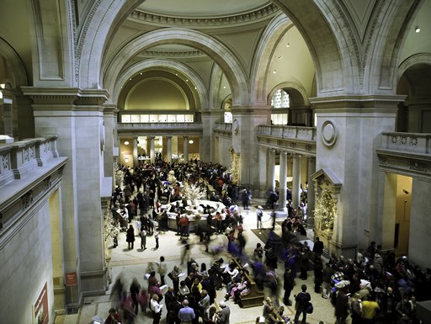
Context: On-Site Visitors
6.3 million visitors last year
Notes:
Largest tourist attraction in New York City, drawing over 5.7 million visitors in FY2011.
Approximately 170,000 individual members and 123 corporate patrons.

Slide 5
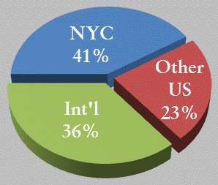
Context: On-Site Visitor Profile
Notes:
Largest tourist attraction in New York City, drawing over 5.7 million visitors in FY2011.
Approximately 170,000 individual members and 123 corporate patrons.

Slide 6
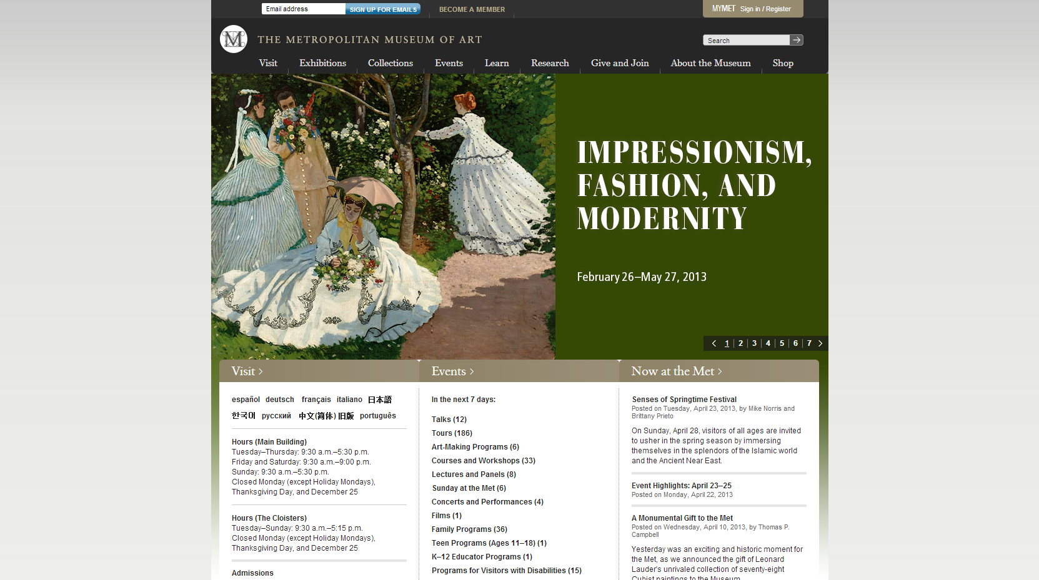







Context: metmuseum.org
44 million visitors last year
Plus pages on…
www.metmuseum.org
Notes:
The Met’s website puts our exhibitions in the spotlight. Since our launch we have seen an enormous growth in visitor numbers.
In addition to the main site, the Met maintains pages on the following interactive sites: Flickr YouTube Twitter Facebook

Slide 7
Related Opportunities
Museum Director Tom Campbell’s vision and his commitment to leverage technology to enhance the visitor experience on-site and on-line, and to deepen the Met’s interactive relationship with our audience.
The launch of the Met’s new website in the fall of 2011, featuring pace-setting content – the Timeline of Art History…Connections…82nd & Fifth – that is digitally broadening the Met’s audience.
Increased on-line interaction with our audience – through the website, in general, and transactionally, e.g., memberships, merchandise, enrollment for events/classes, etc.

Slide 8
The Result
An institutional commitment to invest in resources – including staffing and consultants – to explore this emerging opportunity.

Slide 9
ePhilanthropy at the Met
Create an emotional resonance for our audience, building authentic relationships through content and engagement, and leveraging those relationships toward financial ends.
Focus on integrated marketing and fundraising - tying together outbound emails, social media, onsite promotion and paid search to generate higher levels of digital engagement.
Invest in technology and optimize landing pages for higher conversion.
Test new tactics, and learn from mistakes.

Slide 10
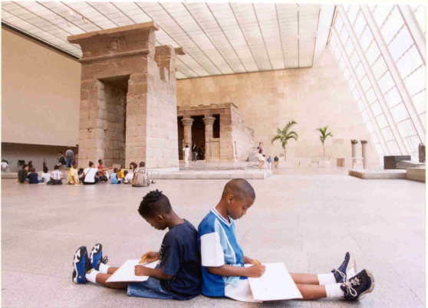
Examples: Annual Appeal
When?
  Two Campaigns Annually
    End of Calendar Year
    End of Fiscal Year
  “Arc” with 3 to 5 sends
  Culminates on the last day to give
    Instills a sense of urgency
Who? Anyone with an email address!
  Active Members, Lapsed Members, non-Member Donors, website registrants
    Suppress Members in the renewal cycle
  Occasionally include Met Store email registrants and online ticket buyers
Notes:
More than 214,000 schoolchildren and teachers participated in tours, workshops, and other enrichment classes in FY2011

Slide 11
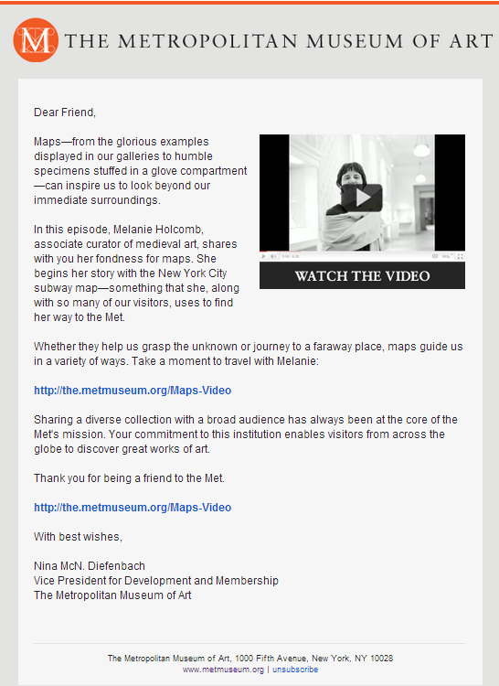
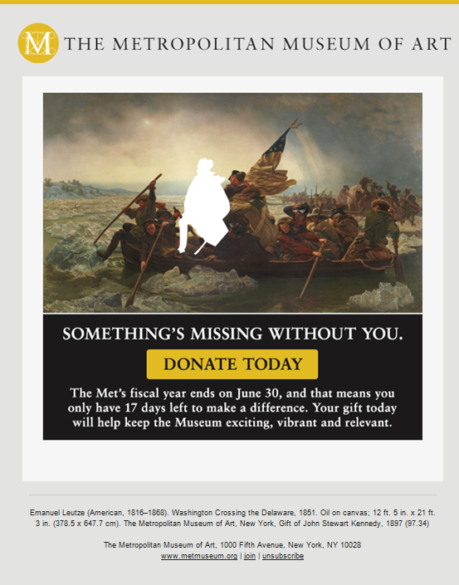
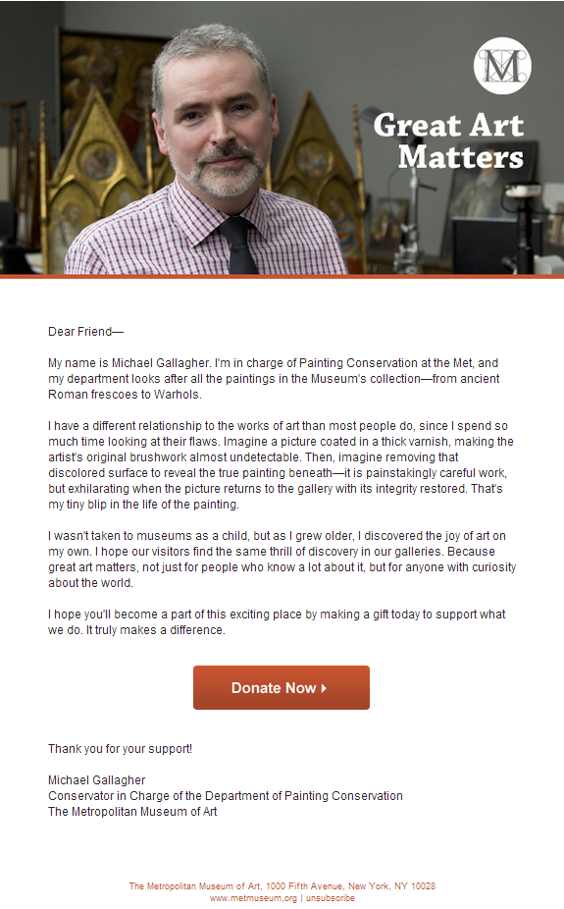
Online Campaign Content
Campaign Content
  Re-purposed existing
  digital content
Focused on the iconic works from the collection
  Featured different voices to make personal connections

Slide 12
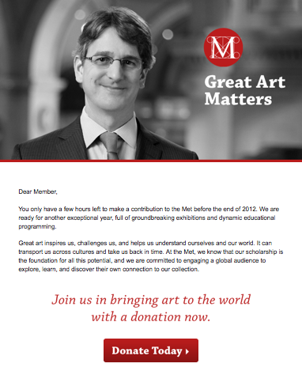
Opportunities to Test
Test, Test, Test!
    Email appeals are easy to segment
    Test a variety of components:
        Sender and signatory
          “from the Director” vs.
          “from the Museum”
        Subject line
        Design
        Ask strings
        Video vs. no video
        Message
          Letter vs. short message
        Day of the week / Time of day
        And, of course, IMAGES
    Provides quick results and answers
      “10/10/80” test-and-send
    Email can serve as a litmus test
    for messaging in other channels.
Notes:
Test amply, and act on the intelligence you gather.
Except in the cases when urgency prevents your spending time on an A/B
test, there’s simply no reason not to test something every single time.
(We’re referring to tests where small portions of the list receive slightly
variant versions of a single message, the results are compared, and the
“winning” approach is extended to the bulk of the list.) Items to test include:
• Subject lines
• Sender names
• Sender name format (e.g., “Barbara Dougherty” vs. “Barbara
Dougherty, Metropolitan Museum of Art” vs. “Barbara Dougherty, The
Met” vs. “Barbara Dougherty, MetMuseum.org”)
• Email template (e.g., large art header vs. smaller Met logo template)
• Email structure (e.g., one link vs. two, long vs. short)
• Graphic format (e.g, top‐right vs. center; call‐out box vs. standard
graphic)
• Link format (e.g., hyperlinked text vs. displayed URLs)
• Voice (e.g., formal vs. friendly)
• Message (e.g., upbeat vs. stark)
• Appeal content (e.g., community focus vs. financial‐need focus)
• Appeal amount (e.g., $50 vs. no specific amount)
Though they may seem trivial, these slight variations can have an enormous
impact on the performance of an email. In one example from a campaign
we conducted for another cultural institution, a random sample of lapsed
upper‐level Members who were asked to give, but not offered a suggested
amount, gave 51 percent more than an identical random sample asked to
give a specific amount.
And the benefits of testing won’t just be felt on an email‐by‐email basis.
Over time, you’ll be able to develop intelligence on the long‐term patterns
of your list that will guide your tactics and messages. Suppose, for example,
that emails mentioning a given artist consistently out‐perform emails
mentioning other artists; you’ll know to mention him or her in every appeal
thereafter — knowledge which, on top of improving your yield across the
board, will also leave you free to test other things.

Slide 13
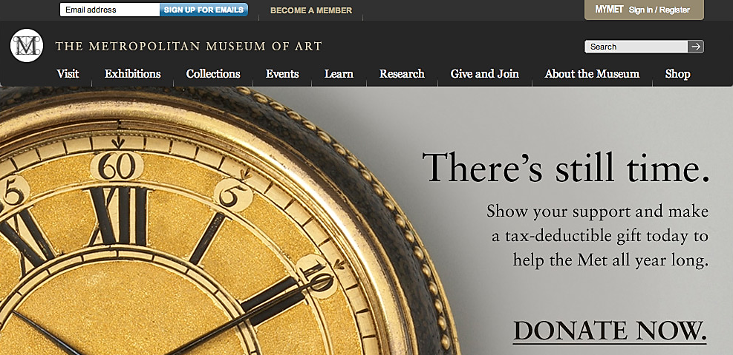
Opportunities to Increase Visibility
Increase Visibility
    Home Page Banners
  Main Museum Website
    “Ads” on highly-trafficked pages

Slide 14
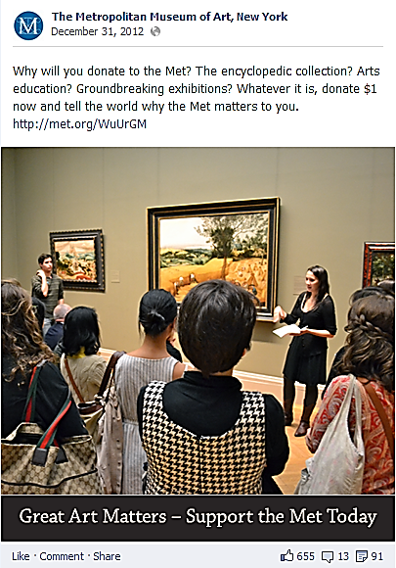
Opportunities to Increase Visibility
Increase Visibility
Large and growing social
media following
Not used to monetary asks
through this channel
Why do it?
Increases engagement
Reaches a wider, more diverse audience
Important to remind this audience that the Museum relies on donor support
  Social Media
Notes:
According to the 2012 Nonprofit Social Network Benchmarking Report, 98% of nonprofits didn’t raise any money on Facebook in 2012. Social media is currently viewed as a source to generate increased engagement and acquisitions, and we will continue to try to cultivate this audience and produce additional revenue. We need to work with DM to add a Membership tab to the Facebook page. This would help educate this new audience about the benefits of Membership and encourage them to learn more.

Slide 15
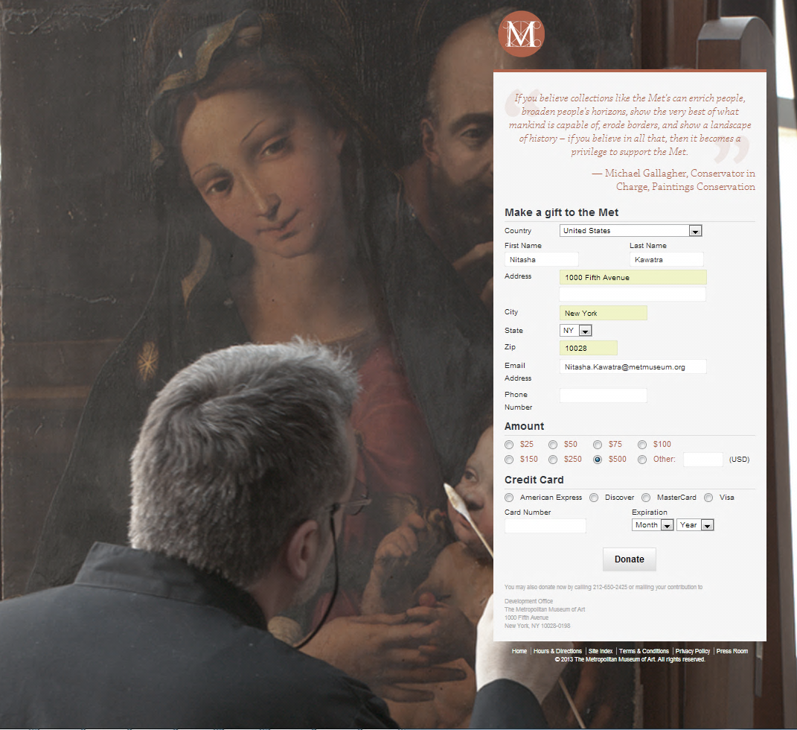
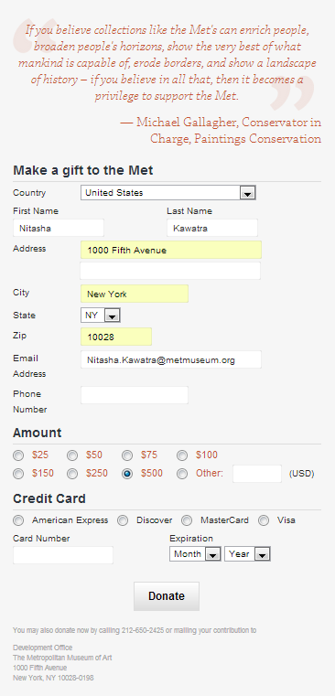
Tracking Donations
  Emails and online placements linked to a campaign-specific landing page, tracked revenue and source
      This was the online “hub” of the campaign
  Three versions of the landing page: “low,” “medium,” or “high” ask string
  Email segments based on past giving history or Membership level

Slide 16
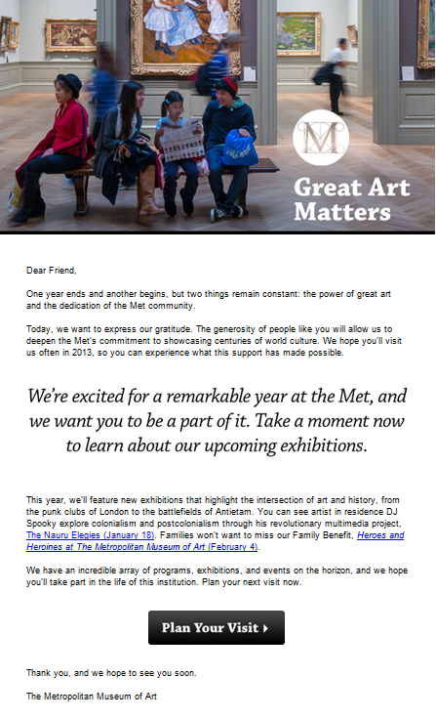
RESULTS
The End of Calendar Year Annual Appeal campaign brought in a total of $216,785.95 in revenue – an increase of 200% over the 2011 EOY campaign.
98.2% of donation revenue generated on Blue State Digital landing pages was attributed to email, proving email to be the strongest way to target people within the existing Met community.
Of the 3,561 individuals who gave to the Museum at year-end, either offline or on the MMA’s main site, 1,051 opened one of the BSD EOY campaign emails. The email openers represent 30% of the total offline donor body, which exemplifies the importance of integrated marketing.
Notes:
2012 was a banner fundraising year for the Met, despite a tumultuous fundraising climate with a political election and Hurricane Sandy. Yet even in the presence of these challenging external circumstances, BSD worked with the Met to develop the most integrated and successful End-of-Year campaign for the Museum to date.
The EOY campaign, which included outbound emails, social media, onsite promotion, and paid search generated high levels of digital engagement across the board. The BSD pages alone brought in a total of $216,785.93 in revenue, an increase of over 200% from the 2011 EOY campaign.

Slide 17
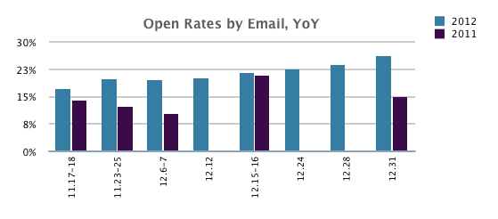
The 2012 emails generated higher open rates than those during the same time period in 2011.

Slide 18
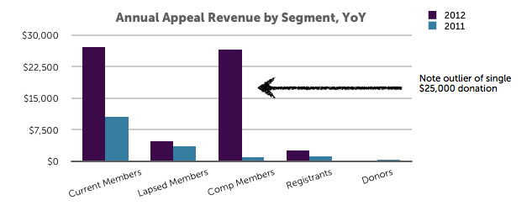
Over the course of November and December there were year over year increases in revenue raised across almost all segments, with most segments showing 30–200% increases from 2011.
Notes:
Donors were the only segment that showed a decrease in total revenue year over year. This is a may be a symptom of the lack of engaging content offered to this segment. Until the Development newsletters sent in September, October, and November, the list received nothing but donation asks, which took a toll on annual appeal conversions. We need to continue generating a regular content stream, including non-donate asks, for all segments.

Slide 19
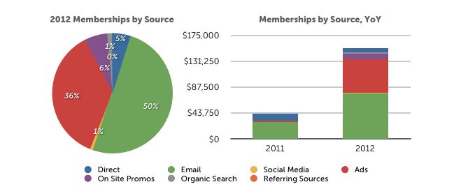
December was the largest month for new and renewed memberships in the Met’s online history, due in part to the cross-channel promotional efforts, as well as a tremendously successful Paid Search campaign. A total of $811K was generated from 4,516 online memberships.

Slide 20
Campaign Strategy
Define key success factors for integrated, multi-channel marketing such as:
Staffing
Goal setting
Inter-departmental coordination

Slide 21
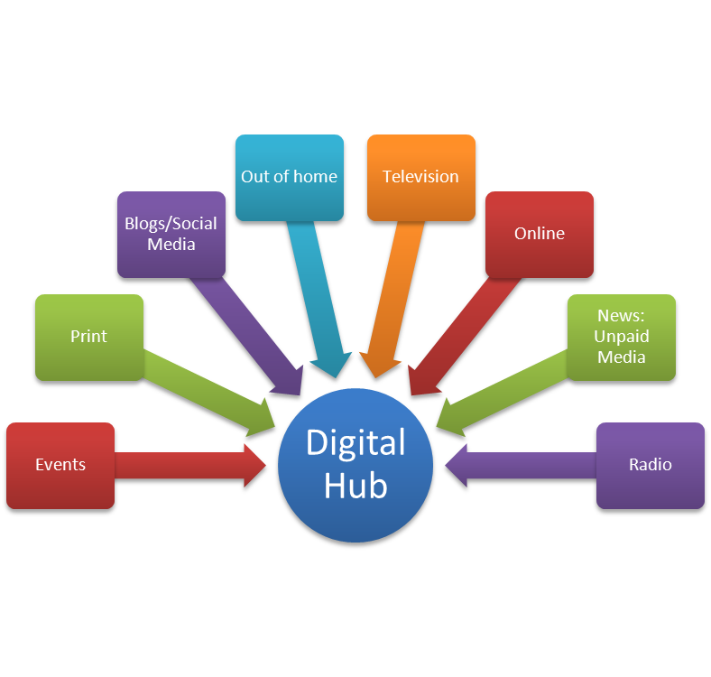
Campaign Strategy
Driving to “the hub”
From the PSA down to the smallest print ad, all communications will direct to a landing page that will serve as the hub of the campaign

Slide 22
Optimize Your Website
Prominent, contextual email sign-up integrated within the landing page
One interaction is not enough/Risk of losing first-time visitors
Build an iterative road map that begins with triggered messaging tactics and evolves into personalization and a deeper dialog with website visitors
Ask the following questions
  Does it drive new audiences to the Museum/Museum website?
  Does it improve conversion rates?
  Does it help spread the mission
  Does it engage our constituents coherently across channels

Slide 23
Integrated
Marketing
Pyramid
Integrated Mktg
Cultivation
MajorDonor
Mid-Donor/
Super-supporter
Integrated Mktg
Cultivation
Small Donor/Supporter
Integrated Mktg
Cultivation
Points
of
Entry
List Member/Community
Sticky Site/Integrated Mktg
Drives List Growth
Website Visitor
Search/PR/Mktg/Events
Drive Web Traffic
Brand Awareness
Framework for Integrated Online Marketing, Communications, and Fundraising

Slide 24
Drive emotional impact by integrating siloed touch-points in one holistic experience model with digital at the nexus.
Each channel has its particular strengths, but by defining digital as the nexus of the channel experience and driving all actions to digital, organizations not only see operational efficiencies, but also take further advantage of digital’s strength as a way to offer a cascade of potential actions.

Slide 25
Touchpoints drive users closer – or push them away – as they engage with you through the “Constituent Relationship Lifecycle”
Pre-Donation → Donation → Post-Donation
Awareness
Knowledge
Consideration
Selection
Satisfaction
Loyalty
Advocacy
Thank You Email
Email Marketing
Online Donation
Video Story
Website Visit
Google AdWord

Slide 26
The simplicity and focus of a landing page can be further expanded to be in sync with all direct efforts from phone calls, to direct mail to the membership desk. The goal is to drive a deeper more long-term interaction beyond just buying a ticket or making a donation.
Incenting people to tap into their social networks, or taking a survey, or sharing a story can be part of a cascade of potential actions that over time could turn prospects and members into donors.

Slide 27
Redefine the user relationship at every interaction point. Turn prospects into a greater number of engaged users who will participate, advocate and donate.

Slide 28
The biggest mistake you can make is making it about you. It’s about the audience.
•Marketing is not usually a monologue.
•You are not necessarily the target audience.
•Successful online engagement and fundraising campaigns are about looking at the world from the point of view of your audience rather than our own.

Slide 29
Benchmarking and Goal Setting
Are you counting, or are you measuring?
  Counting provides a number where as measuring provides insight and context = value
Success is more than $$ raised
  Think of the business world
  Expand the definition of success

Slide 30
Success isn’t always instantly measurable. The question “Did it work?” does not always track back to an immediate purchase/donation.
Develop broader performance indicators that can track the longer term relationship with a constituent and help you understand the true overall value that person can bring.
Identifying expanded behavior metrics that can be traced to desired actions will increase your body of knowledge and widen the opportunity for targeted influence over behaviors.

Slide 31
Questions???

Slide 32
Thank you!
The Metropolitan Museum of Art

