Slide 1
Philanthropic Trends AMDA 2013
Lynne LaMarca Heinrich | Senior Consultant & Principal
May 9, 2013

Slide 2
In General

Slide 3
In General
2013++ Campaigns Campaigns Campaigns!!
Campaigns continue to be top heavy
Donors are distracted, continue to narrow their focus
Multiple approaches necessary for ultimate gifts
Sustainability strategies and business plans essential
Predictive modeling, and frequent adjustments to strategy, are critical. Do the planning.
Quality of leadership really matters to donors
Impact, Urgency. Focus on getting the case right.

Slide 4
In General, continued
Big gifts drive successful campaigns
Big ideas drive big gifts
Endowment campaigns continue to be a difficult slog in this environment:
Typically supported by those close to the institution
Rely primarily on individuals
Not a favorite of the newly wealthy
Lack urgency
Often done via estate/planned gifts
Some success with term endowments

Slide 5
What Is A Big Idea?
A philanthropic investment opportunity that transforms the organization or its ability to deliver on its mission
Demonstrating impact is essential
74% of wealthy donors cited impact as a primary motivator for giving in the most recent Bank of America study
But a big idea is not simply:
A gift opportunity with a big price tag
The bundling together of a collection of smaller ideas
An opportunity to put your name on something

Slide 6
Final General Thoughts
Campaigns can inspire significant institutional change!
Generation of important new ideas
Institutional priority-setting, focus
Volunteer leadership transitions, strengthening of roles
Resourcing, investment levels
Focus on talent development

Slide 7
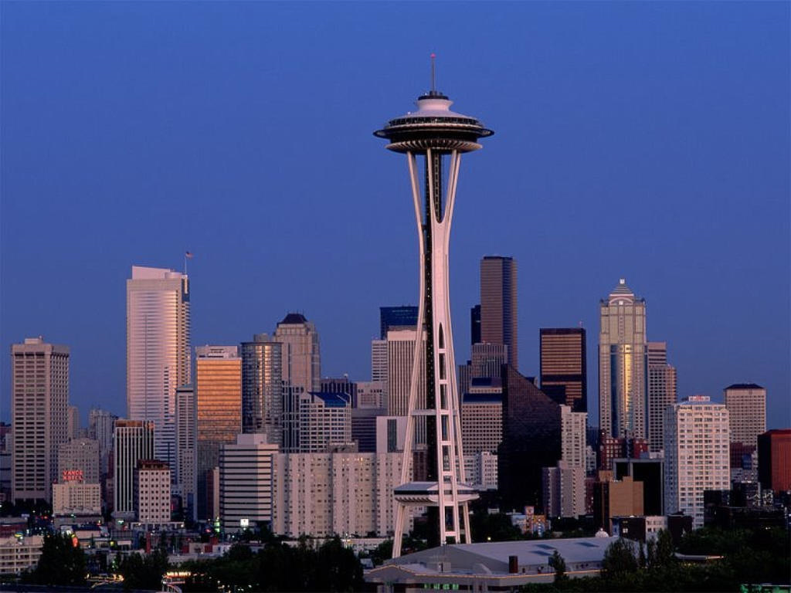
Trend #1:
Top of the Pyramid and
How Much Harder Is It For Culturals?
Source: Chronicle of Philanthropy, cash only

Slide 8
$1M+ Gifts to Higher Education (includes bequests)

Slide 9
$1M+ Gifts to Arts & Culture (includes bequests)

Slide 10
All $1M+ Gifts: Compare A&C to Higher Ed. (includes bequests)

Slide 11
$1M - $4.9M: Compare A&C to Higher Ed. (includes bequests)

Slide 12
$5M-$9.9 Gifts: Compare A&C to Higher Ed. (includes bequests)

Slide 13
$10M-$24.9M Gifts: Compare A&C to Higher Ed. (includes bequests)

Slide 14
$25M+ Gifts: Compare A&C to Higher Ed. (includes bequests)

Slide 15
Trend #2:
What Do Donors Want?

Slide 16
Graduate Level Learning Experiences
Meaningful Engagement Opportunities
Transparency
Priorities
A Chance To Make A Difference

Slide 17
Trend #3:
Welcome to the World of Talent Development!

Slide 18
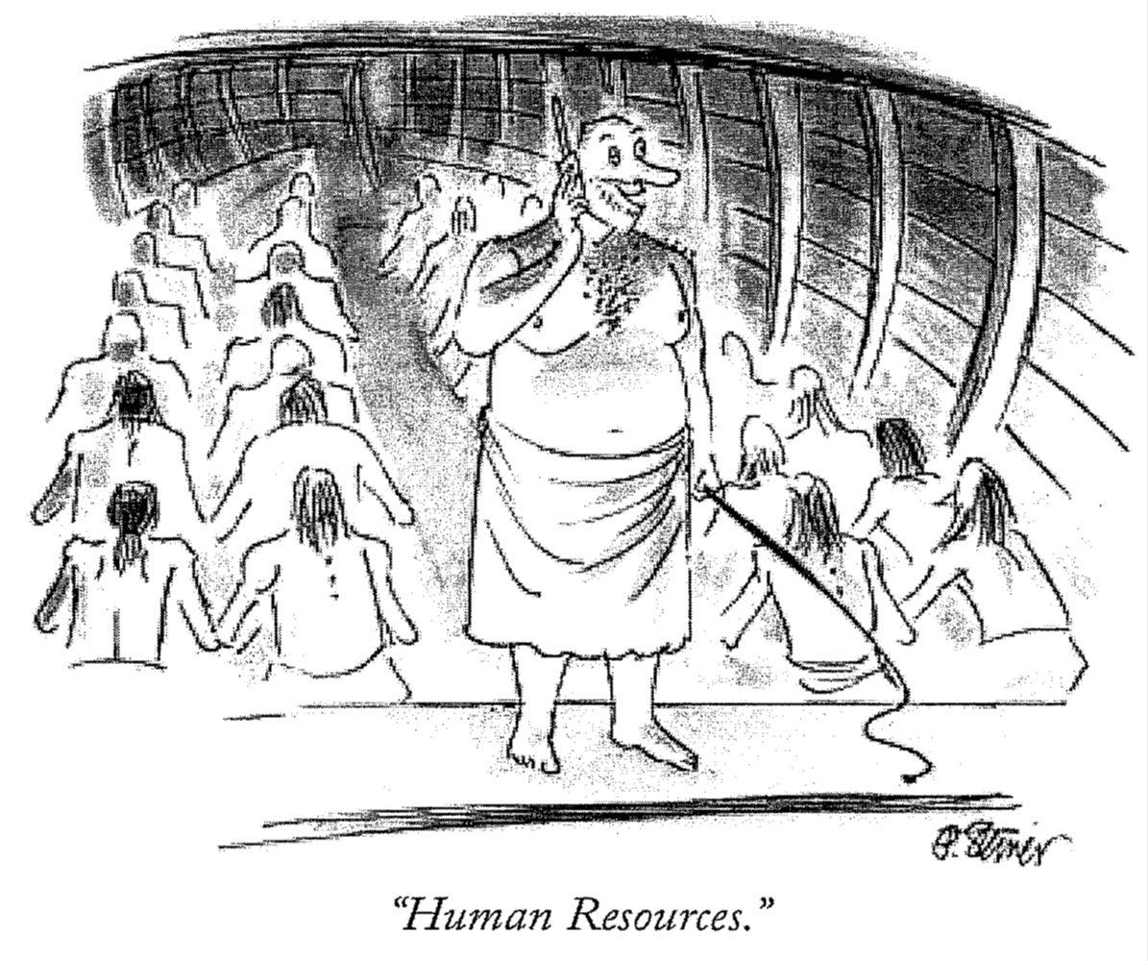

Slide 19
Recruitment and retention are two of the biggest challenges facing the field
People are moving again
Expectations are out of alignment with resources
Salaries for top positions and front line fundraisers are competitive – culturals are at a disadvantage
Higher ed is taking talent management very seriously
The opportunity costs are great – turnover is expensive

Slide 20
Frederick Herzberg in the 21st century: People Join Organizations; They Quit Leaders
People want to be part of something bigger than themselves:
Demonstrating and connecting the mission makes people see the greater sense of meaning in their work. Responsibility is a motivator
People want to feel a sense of belonging:
Being left out of information, they begin to distrust leadership and become disengaged.
Recognition is a motivator

Slide 21
Frederick Herzberg in the 21st century: People Join Organizations; They Quit Leaders
People want to go on a meaningful journey with their employer:
What is the destination, the progress and the role of the employee
Advancement is a motivator
People want to know that their contribution makes a significant difference
It’s how we feel important
Achievement is a motivator

Slide 22
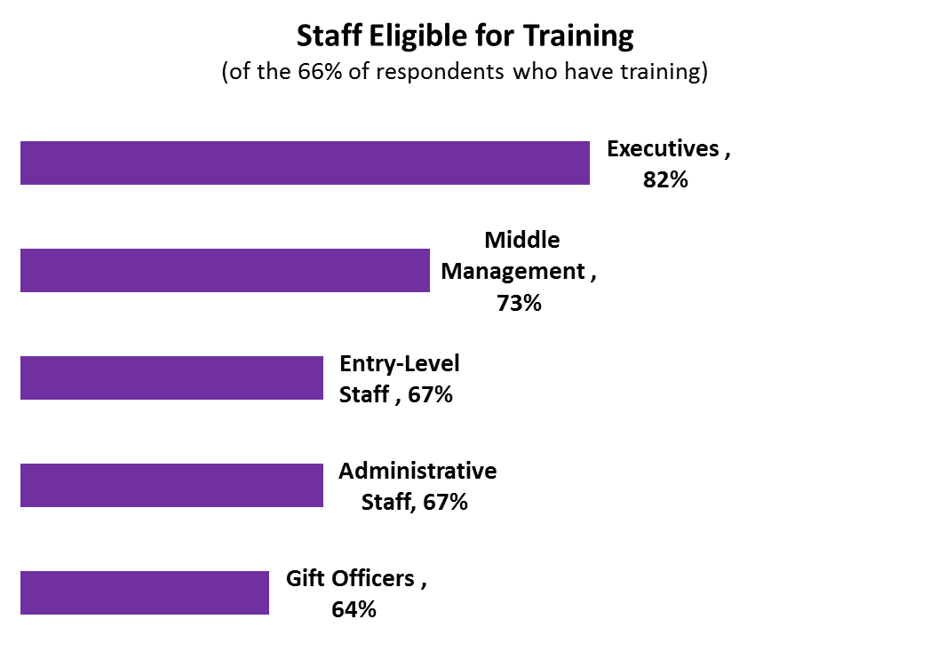
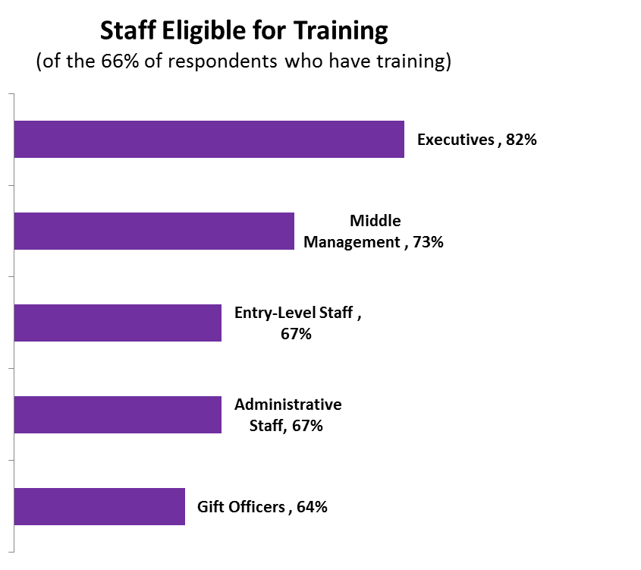
AMDA Salary Survey 2013: Training

Slide 23
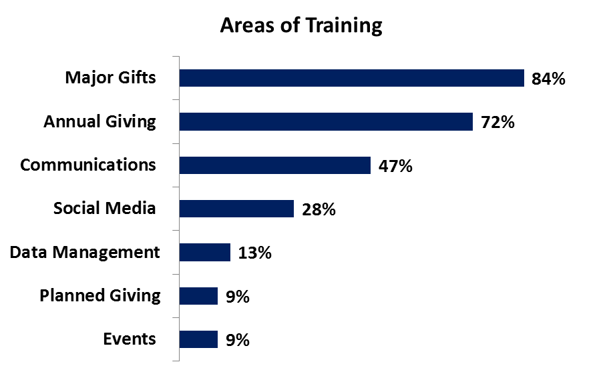

Slide 24
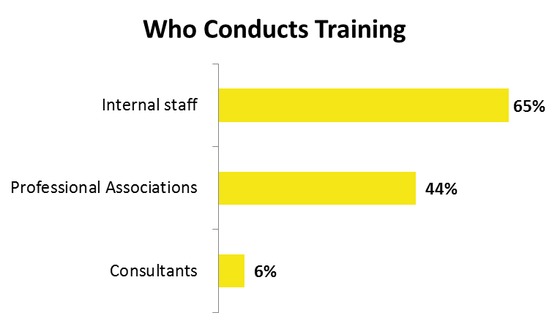

Slide 25
Retention
Chief Development Officer Open-Ended Responses:
“Best tools for retaining staff”

Slide 26
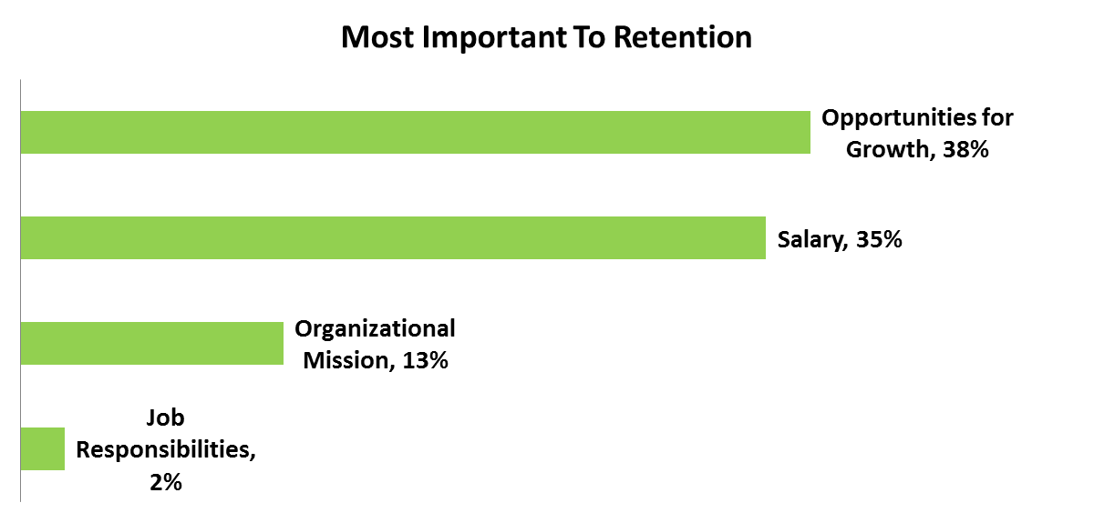

Slide 27
AMDA Survey: Bonus Pay
Only 10% of respondents indicated they had a bonus structure.
Eligibility:
Of the 10% with bonus programs, all identified Executives, Middle Management, and Gift Officers as eligible for bonuses. An additional 60% also included Entry-Level Staff and 40% also indicated Administrative Staff are eligible.
For most respondents, the maximum bonus would not exceed 5%. One respondent indicated the maximum bonus was 16-20%.

Slide 28
Trend #4:
Miscellaneous

Slide 29
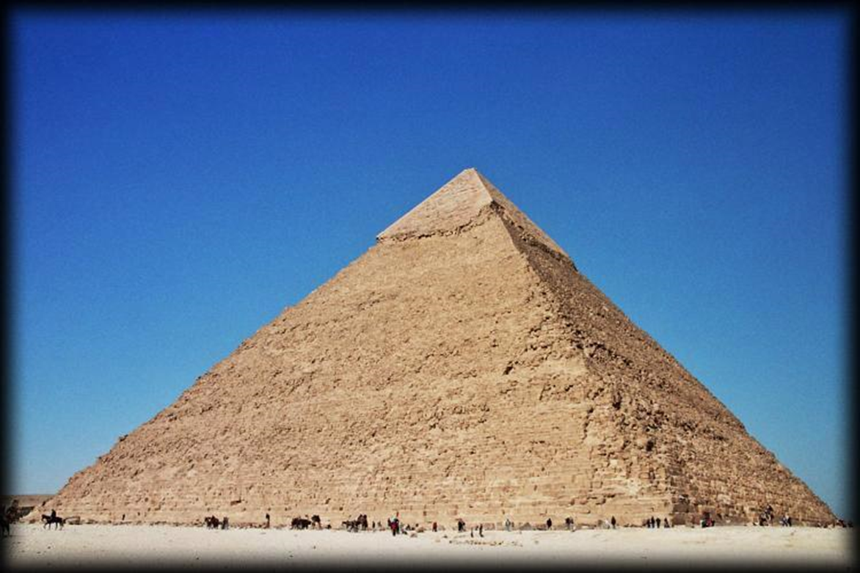

Slide 30
Middle of the Gift Pyramid: AMDA Survey
Only 10% of respondents listed positions focused on the middle of the pyramid, such as leadership annual giving.
Are all in major metropolitan areas
Most had revenue in the $25M+ range, though one was at approximately $6M
All are either in the planning or leadership (silent) phases of a capital campaign

