Slide 1
ART MUSEUM DEVELOPMENT ASSOCIATION
A Philanthropic Trends Update
May 2013
Jim Hackney, Managing Partner

Slide 2
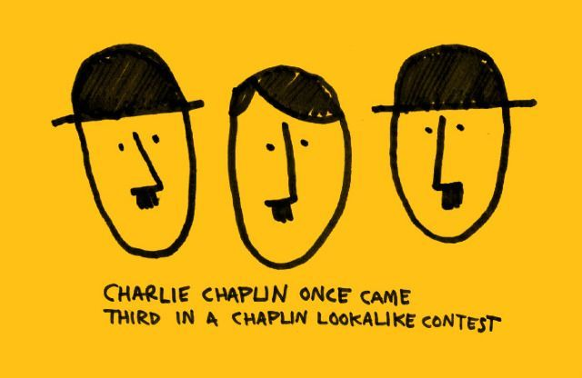
Over View: The FACTS
Notes:
Section header

Slide 4
GIVING USA 1996
$150.70 BILLION
Uses of Contributions
Source: Giving USA 1997/AAFRC Trust for Philanthropy
Notes:
4

Slide 5
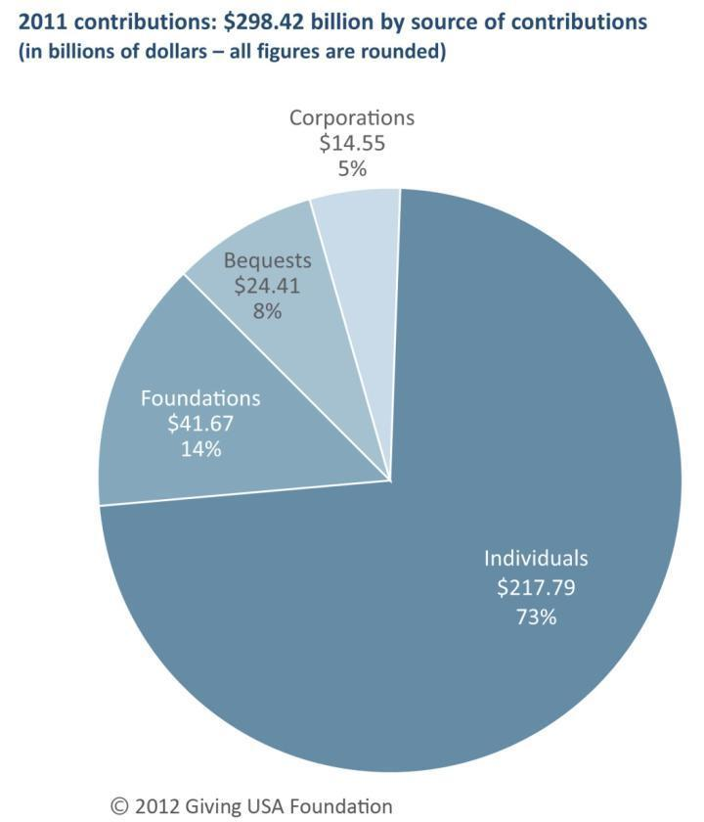
2011 charitable giving Total = $298.42 billion
Source: Giving USA Foundation™/GIVING USA 2012
Notes:
Total giving = $298.42 billion¹
Increase of 4.0 percent (0.9 percent adjusted for inflation)
Individuals remain the single most important source
Individuals + charitable bequests = 81 percent of total
Foundation grantmaking = 14 percent of the total²
About three-fifths of independent foundation giving is from family foundations
Individual + Bequest + Family Foundations = 88 percent
Corporate giving is an estimated 5 percent of the total
Giving by individuals—which includes estimated amounts for charitable deductions claimed on tax returns filed for 2011 and charitable giving by individuals who did not itemize deductions—comprised 73 percent of all gifts given in 2011. This is the same proportion of giving as in 2010, according to Giving USA’s revised estimates.¹
Foundation grantmaking by independent, community, and operating foundations amounted to 14 percent of all gifts given in 2011. This is the same proportion of giving as in 2010, according to Giving USA’s revised estimates. Grantmaking by family foundations, which is about 59 percent of independent foundation grantmaking, accounted for 7 percent of total giving in 2011.²
Giving by charitable bequest—which includes an estimate for charitable bequests claimed on estate taxes and an estimate for those estates that do not file with the IRS—accounted for 8 percent of all gifts given in 2011. This is the same proportion of giving as in 2010, according to Giving USA’s revised estimates.
Giving by individuals, bequest, and family foundations amounted to 88 percent of total giving in 2011. This figure is one percentage point higher than in 2010, according to Giving USA’s revised estimates.
Giving by corporations comprised 5 percent of total giving in 2011. This is the same proportion of giving as in 2010, according to Giving USA’s revised estimates.
Continue to see philanthropy as a core American value.
This year’s results show the beginning of the climb back to “normalcy” – shows progress and slow climb back upwards.
2011’s results growth in particular reflects the growth of the economy –very closely linked – the results show growth from 2010 but slow growth – overall giving for 2011 shows slow but positive growth in giving – overall encouraging results.
Family Foundations – today decisions are being made by original family members.
Role of individual giving is huge – 73% of total, and 88% of total giving with the inclusion of bequest and family foundations. 9 out of every 10 dollars come from individuals.

Slide 6
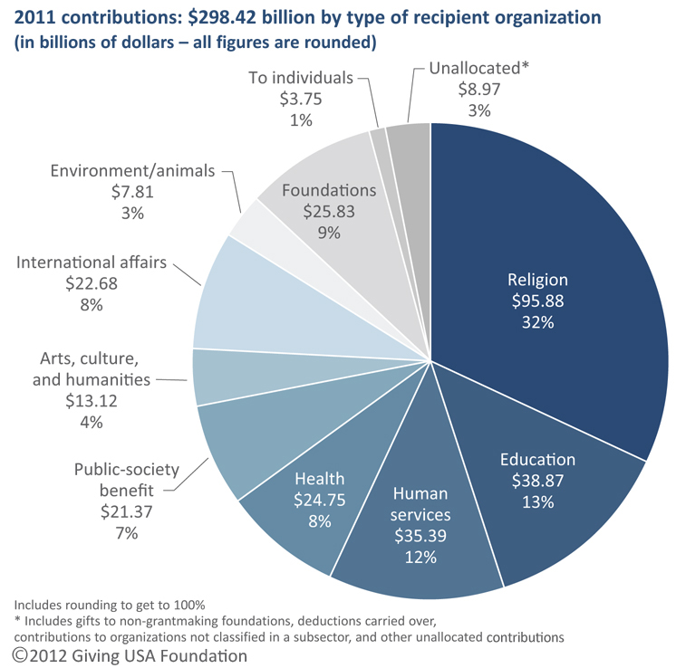
Types of recipients of contributions, 2011 Total = $298.42 billion
Source: Giving USA Foundation™/GIVING USA 2012
Notes:
Religion remains the largest single recipient at 32 percent of total³
• After religion, next highest categories are:
Education 13 percent
Human services 12 percent
To foundations 9 percent
• Estimates are grounded in economic and demographic data, as well as data submitted by organizations to national agencies and independent research organizations.
Revisions made when new data available⁴
• Unallocated includes gifts to government agencies, direct to public schools (public school foundations are included, however), or new charities; grants to organizations in other countries; and differences in fiscal year Every year, the religion subsector receives the largest share of charitable dollars. In 2011, religious organizations received an estimated 32 percent of the total. However, this was a two-percent decline from revised estimates for giving to religion in 2010.³
The education subsector received the second-largest share of charitable dollars in 2011, with an estimated 13 percent of the total. This is the same proportion of gifts received as in 2010, according to Giving USA’s revised estimates.
The human services subsector received the third-largest proportion of charitable dollars in 2011, with an estimated 12 percent of the total. This is the same proportion of gifts received as in 2010, according to Giving USA’s revised estimates.
Charitable gifts to independent, community, and operating grantmaking foundations accounted for the fourth-largest share of charitable dollars in 2011, with an estimated 9 percent of the total. This is a one-percent drop from 2010, according to Giving USA’s revised estimates.
The health subsector was tied with the international affairs subsector for the fifth-largest proportion of charitable dollars received in 2011, at 8 percent each. Health organizations received 9 percent more in charitable gifts than the international affairs subsector. In 2011, the health subsector received the same proportion of gifts as in 2010, but the international affairs subsector saw its proportion rise one percent from 2010, according to Giving USA’s revised estimates.
The public-society benefit subsector received the sixth-largest proportion of charitable dollars in 2011, with an estimated 7 percent of the total. This is the same proportion of gifts received as in 2010, according to Giving USA’s revised estimates.
The arts, culture, and humanities subsector received the seventh-largest proportion of charitable dollars in 2011, with an estimated 4 percent of the total. This is the same proportion of gifts received as in 2010, according to Giving USA’s revised estimates.
The environment/animals subsector received the eighth-largest proportion of charitable dollars in 2011, with an estimated 3 percent of the total. This is the same proportion of gifts received as in 2010, according to Giving USA’s revised estimates.
Individuals received an estimated one percent of total charitable dollars in 2011. This is the same proportion of gifts received as in 2010, according to Giving USA’s revised estimates.
Giving overall remains the same in 2011 as in 2010 among recipient organizations, except for a decline in giving to religion and foundations.

Slide 7
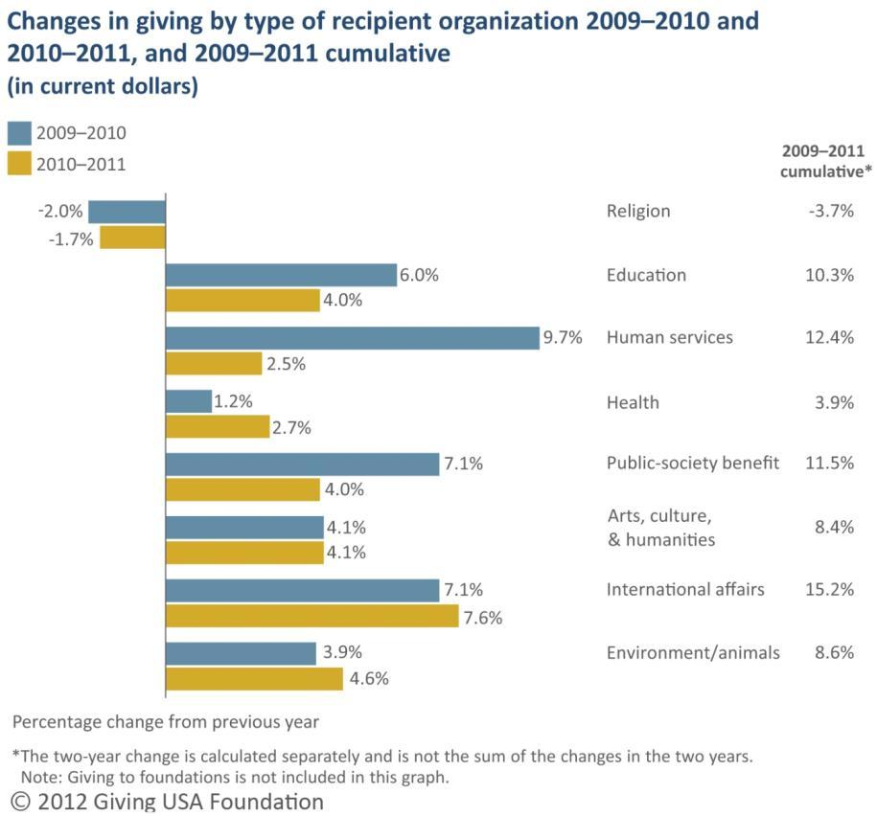
Changes in giving by recipient organization, 2009–2011 Current dollars
Source: Giving USA Foundation™/GIVING USA 2012
Notes:
Estimated giving in current dollars held steady or increased modestly in all subsectors except international affairs, which saw a sizable increase, and religion, which saw a slight decrease.⁷
For 2011, Giving USA estimates growth in giving to:
International affairs 7.6 percent
Environment/animals 4.6 percent
Arts, culture, and humanities 4.1 percent
Public-society benefit 4.0 percent
Education 4.0 percent
Health 2.7 percent
Human services 2.5 percent
Only the religion subsector saw a decline in 2011:
Religion –1.7 percent
Total charitable giving increased in current dollars by an estimated 4.0 percent between 2010 and 2011. Total contributions in 2010 were revised from figures reported in Giving USA 2011 to show an increase of 3.0 percent from 2009. These changes reflect adjustments based on the receipt of final IRS Forms 990 data on charitable contributions made to recipient organizations, reported changes in the economic variables used in the Giving USA estimation models, and other factors.⁷
Giving to the religion subsector decreased 1.7 percent between 2010 and 2011, according to revised Giving USA estimates. This change is compared with a decline of 2.0 percent between 2009 and 2010. The estimated two-year change in charitable giving to religion-related organizations between 2009 and 2011 is a decline of 3.7 percent—the only cumulative drop in giving seen across the subsectors for these two years.
Giving to the education subsector increased an estimated 4.0 percent from 2010 to 2011. This follows an increase of 6.0 percent between 2009 and 2010. The estimated two-year change in charitable contributions made to educational organizations between 2009 and 2011 is an increase of 10.3 percent.
Giving to the human services subsector increased an estimated 2.5 percent from 2010 to 2011. This follows an increase of 9.7 percent between 2009 and 2010. The estimated two-year change in charitable contributions made to human services organizations between 2009 and 2011 is an increase of 12.4 percent—the second-largest increase across the subsectors.
Giving to the health subsector increased an estimated 2.7 percent from 2010 to 2011. This follows an increase of 1.2 percent between 2009 and 2010. The estimated two-year change in charitable contributions made to health organizations between 2009 and 2011 is an increase of 3.9 percent—the smallest positive change across the subsectors.
Giving to the public-society benefit subsector increased an estimated 4.0 percent from 2010 to 2011. This follows an increase of 7.1 percent between 2009 and 2010. The estimated two-year change in charitable contributions made to public-society benefit organizations between 2009 and 2011 is an increase of 11.5 percent.
Giving to the arts, culture, and humanities subsector increased an estimated 4.1 percent from 2010 to 2011, as well as from 2009 to 2010. The estimated two-year change in charitable contributions made to arts organizations between 2009 and 2011 is an increase of 8.4 percent.
Giving to the international affairs subsector increased an estimated 7.6 percent from 2010 to 2011. This follows an increase of 7.1 percent between 2009 and 2010. The estimated two-year change in charitable contributions made to international affairs organizations between 2009 and 2011 is an increase of 15.2 percent—the largest increase across the subsectors.
Giving to the environment/animals subsector increased an estimated 4.6 percent from 2010 to 2011. This follows an increase of 3.9 percent between 2009 and 2010. The estimated two-year change in charitable contributions made to environmental and animal organizations between 2009 and 2011 is an increase of 8.6 percent.
Human services: Second largest increase among subsectors. Growth is still subdued compared to giving to Haiti in 2010, and individuals beginning to feel more comfortable giving to organizations they gave to in the past like arts or environmental organizations and not giving towards immediate needs of social service organizations.
Health: Smallest increase among subsectors.
Public-society benefit: hardest subsector to define as these organizations usually serve multiple purposes – umbrella/catch all organizations; includes national donor advised funds, organizations such as United Way, and Jewish Federations.
International Affairs: Largest increase of all the subsectors and the fastest growing subsector by far.
Growth mainly due to an increase in the number of organizations existing.
Growth not because of disaster related giving: giving to the Asian tsunami is considered separate as overseas giving.
Three-quarters of giving to Haiti in 2010 went to organizations in the human service sector.
Top 3 international recipient organizations: Nature Conservancy is at the top (received over $2 billion in 2010), Rotary Foundation is second, and Feed the Children is third.
Results show political or presidential giving has no impact on charitable giving.

Slide 8
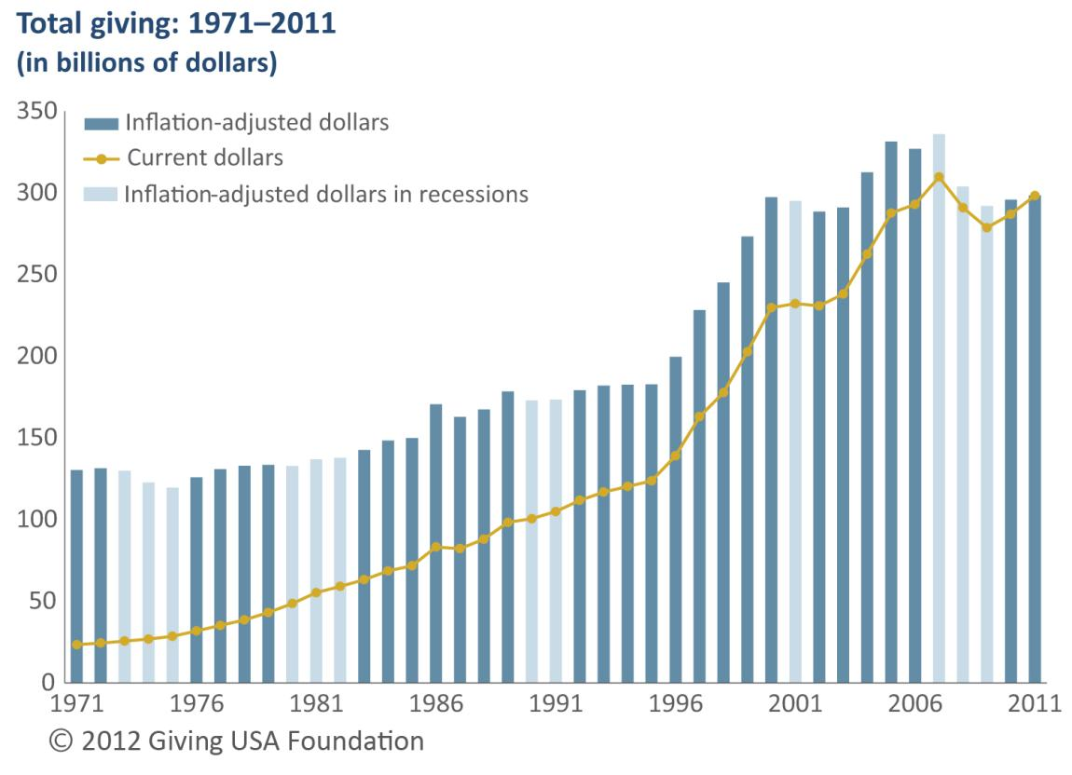
Total giving, 1971–2011
Source: Giving USA Foundation™/GIVING USA 2012
Notes:
Total giving increased in current dollars every year but three since 1971. The exception years include 1987, 2008, and 2009. A 1986 tax law change led some to “give early” to maximize the tax benefit of giving. These results affected giving in 1987.
• Giving grows more slowly—or declines—in recession years.
• In 2008, total giving fell 9.5 percent adjusted for inflation.¹⁰ This is the worst result on record; 2009 follows with a decline in total giving of 3.9 percent, adjusted for inflation.
• The inflation-adjusted increase in 2011 of 0.9 percent is below the average inflation-adjusted rate of change in total giving since 1971, which is 2.3 percent.
History suggests giving will increase as the economy improvesRevised Giving USA estimates show that total charitable giving has increased in current dollars in every year since 1971, with the exception of three: 1987, 2008, and 2009. The average rate of change in total giving in current dollars since 1971 is 6.8 percent. Total giving has not reached that rate of change since 2005, when total giving rose 9.6 percent from 2004.
In 2011, inflation-adjusted total giving is considered to be flat at a 0.9 percent increase. Since 1971, there were eight other instances when the year-to-year change in total giving was flat. These flat changes typically fell on or close to recessionary years.¹⁰
Adjusted for inflation, total giving has declined nine times since 1971. These declines typically fell on or close to recessionary years. The average inflation-adjusted rate of change in total giving since 1971 is 2.3 percent. Total inflation-adjusted giving has not reached that rate of change since 2007, when total giving rose 2.8 percent from 2006.
Since 1971, the average inflation-adjusted rate of change in total giving in the two years following each recession was 2.4 percent. For the years 2010 and 2011, the average inflation-adjusted rate of change in total giving was 1.1 percent, which is on the lower end of the rates of change for these years (-0.07 percent between 2002 and 2003, to 4.7 percent between 1976 and 1977).

Slide 9
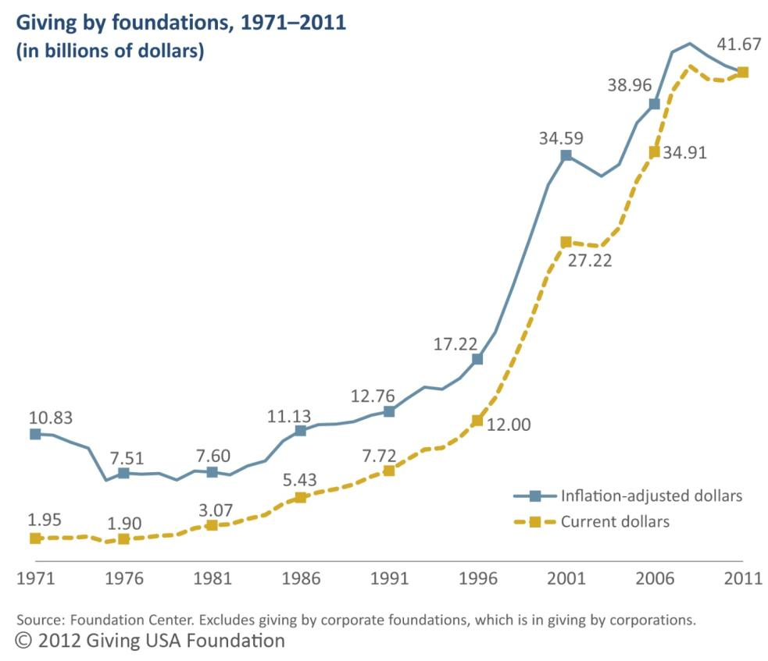
Giving by foundations, 1971–2011
Source: Giving USA Foundation™/GIVING USA 2012
Notes:
The Foundation Center estimates $41.67 billion for giving by independent, community, and operating foundations in 2011 (does not include corporate foundations).¹⁶
• Increase of 1.8 percent (–1.3 percent, adjusted for inflation)
On average, each year, giving by family foundations is estimated to be about 59 percent of giving by independent foundations. For 2011, this amount is $19.5 billion, or 47 percent of total giving by all foundations included in this estimate.¹⁷
• Over the last four decades (1971–2011), average annual inflation-adjusted giving by foundations grew at a slightly slower rate than the average annual rate of inflation, at 3.7 percent and 4.4 percent, respectively.
Grantmaking by independent, community, and operating foundations increased 1.8 percent from 2010 to an estimated $41.67 billion in 2011, according to figures provided by the Foundation Center.¹⁶
Giving by operating foundations realized growth of 2.4 percent in 2011, while giving by independent foundations rose 1.9 percent. Giving by community foundations was flat between 2010 and 2011 at a 0.1 percent decline.
On average, each year, giving by family foundations is estimated to be about 59 percent of giving by independent foundations.¹⁷ For 2011, this amount is $19.5 billion, or 47 percent of total giving by all foundations included in this estimate.
Adjusted for inflation, giving by foundations declined 1.3 percent in 2011. Over the last four decades (1971–2011), average annual inflation-adjusted giving by foundations has grown at a slower rate than the average annual rate of inflation, at 3.7 percent and 4.4 percent, respectively.
Results show a fairly rapid growth since the recession.
2011 data indicates a bit of a ‘hangover effect’ that still reflects the end of the recession low, and due to most foundations operating on a 2-3 year payout schedule.
Results do not include corporate foundations, which is included in the corporate giving total.

Slide 10
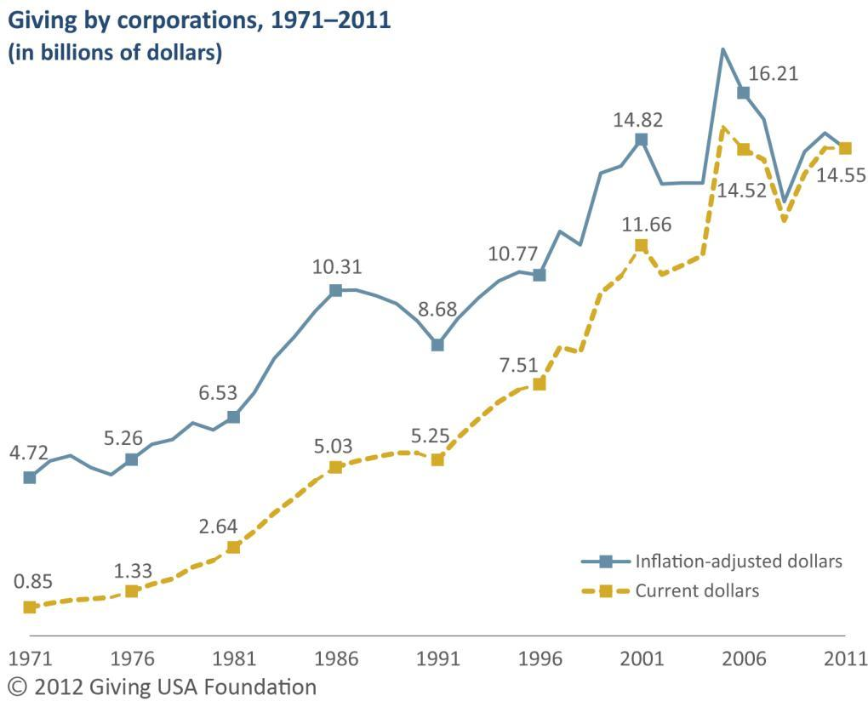
Giving by corporations, 1971–2011
Source: Giving USA Foundation™/GIVING USA 2012
Notes:
Corporate giving = $14.55 billion in 2011
• Adjusted for inflation, giving by corporations is estimated to have declined 3.1 percent in 2011.
Corporate foundation grantmaking is estimated to have grown 6 percent in 2011, with $5.2 billion in contributions. However, for the 2011 Giving USA estimate, $5.15 billion was subtracted from the amount for corporations’ gifts to their own foundations.¹⁸
Giving by corporations is directly linked with companies’ profits and the economic environment in which corporations operate. In 2011, the Gross Domestic Product (GDP) increased 3.91 percent year over year compared with 2010. This is compared with an increase of 4.21 percent between 2009 and 2010.¹⁹
Giving by corporations is estimated to have held steady in 2011 compared with 2010, totaling $14.55 billion (a 0.1 percent decline). Corporate giving includes gifts of cash and in-kind gifts made through corporate giving programs, as well as grants and gifts made by corporate foundations.
Adjusted for inflation, giving by corporations is estimated to have declined 3.1 percent in 2011. Over the last four decades (1971–2011), average annual inflation-adjusted giving by corporations has increased at a slower rate than the average annual rate of inflation, at 3.1 percent and 4.4 percent, respectively.
Corporate foundation grantmaking is estimated to have grown 6 percent in 2011, with $5.2 billion in contributions. However, for the 2011 Giving USA estimate, $5.15 billion was subtracted from the amount for corporations’ gifts to their own foundations.¹⁸
Giving by corporations is directly linked with companies’ profits and the economic environment in which corporations operate. In 2011, the Gross Domestic Product (GDP) increased 3.91 percent year over year compared with 2010. This is compared with an increase of 4.21 percent between 2009 and 2010. More noteworthy is the change in corporate pre-tax profits between 2010 and 2011—a modest increase of 4.2 percent. This is compared with an increase of 25 percent between 2009 and 2010.¹⁹
The Committee Encouraging Corporate Philanthropy (CECP) reported that among respondents to its 2012 Corporate Giving Standard survey, 57 percent of 166 leading global companies reported higher total giving in 2011 than in 2010. A small set of companies that gave a combined total of $1.2 billion more in 2011 than in 2010—predominately in the form of product donations—can be attributed to this increase. If this subset of companies were removed from CECP’s analysis, aggregate giving by the remaining companies would have been flat between 2010 and 2011.²⁰
Corporate giving has become more volatile in the last decade.
Most corporate foundations do not have an endowment or a meaningful endowment – corporations give to foundations and they give to charities.

Slide 11
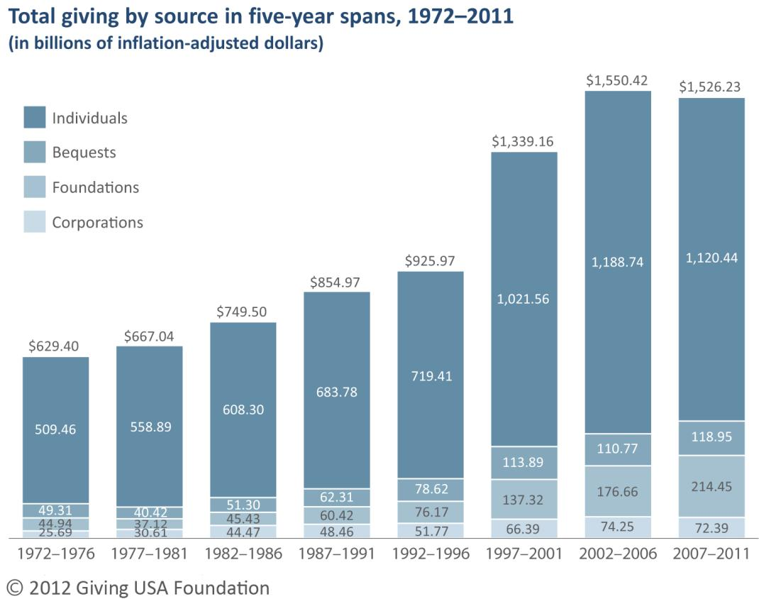
Total giving by source in five-year spans, 1972–2011 (in inflation-adjusted dollars)
Source: Giving USA Foundation™/GIVING USA 2012
Notes:
Over the past 40 years, the major shift has been a growing share of the total coming from foundations and a lower share from individuals. In part, this is because of the increased number of family foundations and their growing assets.
• When divided by the share of inflation-adjusted giving by source, total giving by corporations and bequests have remained consistent over the last four decades.
The share of inflation-adjusted giving by foundations has been on the rise since the mid-1980s.
The share of inflation-adjusted giving by individuals has declined between the five-year period ending in 2006 and the five-year period ending in 2011, dropping from 77 percent of the total to 73 percent of the total. Since the five-year period ending in 1981, the share of giving by individuals has dropped 11 percentage points.
Grantmaking by family foundations has been on the rise for years. Between 2004 and 2009, inflation-adjusted giving by family foundations increased 63 percent.²¹
Total inflation-adjusted giving increased slowly from the five-year period ending in 1976 through the five-year period ending in 1996, with an average rate of change between each five-year period of 10.2 percent. However, giving rose sharply between the five-year periods beginning in 1992 and 1997, with a positive change of 44.6 percent, and again between the periods beginning 1997 and 2002, with a positive change of 15.8 percent.
Despite the earlier increases in inflation-adjusted total giving, contributions began to level off between the five-year periods beginning in 2002 and 2007, with a decline of 1.6 percent.
Inflation-adjusted giving by individuals saw the largest period of growth between the five-year periods beginning in 1992 and 1997, with a 42 percent increase. Giving by individuals realized the largest decline in giving between the five-year periods beginning in 2002 and 2007, with a 5.8 percent decline in giving.
Inflation-adjusted giving by bequest saw the largest period of growth between the five-year periods beginning in 1992 and 1997, with a 44.9 percent increase. Giving by bequest realized the largest decline in giving between the five-year periods beginning in 1972 and 1977, with an 18 percent decline in giving.
Inflation-adjusted giving by foundations saw the largest period of growth between the five-year periods beginning in 1992 and 1997, with an 80.3 percent increase. Giving by foundations realized the largest decline in giving between the five-year periods beginning in 1972 and 1977, with a 17.4 percent decline in giving.
Inflation-adjusted giving by corporations saw the largest period of growth between the five-year periods beginning in 1977 and 1982, with a 45.3 percent increase. Giving by corporations realized the largest decline in giving between the five-year periods beginning in 2002 and 2007, with a 2.5 percent decline in giving.

Slide 12
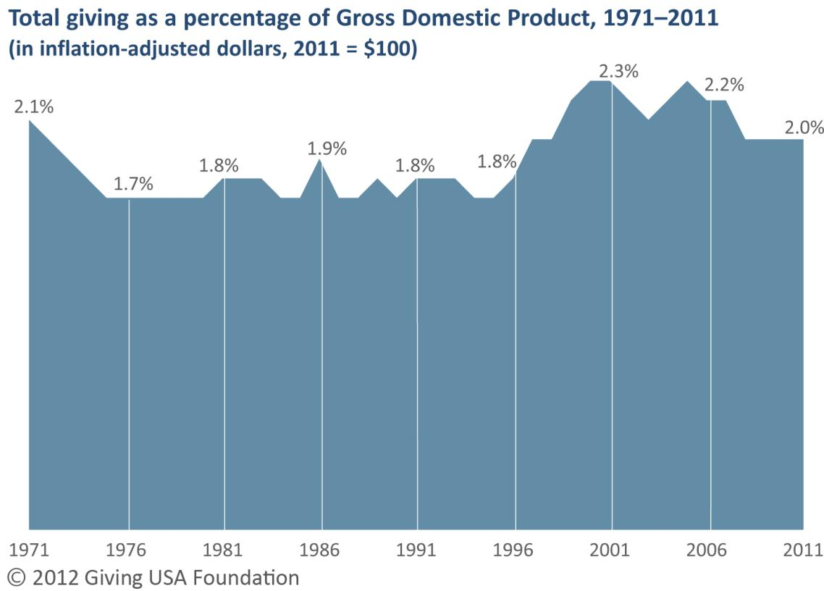
Total giving as a percentage of Gross Domestic Product, 1971– 2011(adjusted for inflation)
Data are rounded.
Source: Giving USA Foundation™/GIVING USA 2012
Notes:
For 2011, giving is an estimated 2.0 percent of GDP.²²⁻²³
• Giving has remained 2.0 percent or more of GDP since 1997.
• From 1956 through 1972, total charitable giving was consistently at or above 2.0 percent of GDP. However, this percentage fell beginning in the period between 1972 and 1996, but rose again beginning in 1997. Total giving as a percentage of GDP has been at or above 2.0 percent since that year.
Several economic factors influence how much donors give to charity. Gross Domestic Product (GDP) is one of those economic factors and is defined as the market value of all goods and services produced within a country’s borders within a specific period of time. It is one of the most important factors considered in measuring the status of a nation’s economic health.²²
Inflation-adjusted GDP increased 0.8 percent from calendar year 2010 to calendar year 2011. This rate of change is compared with inflation-adjusted growth in total giving of 0.9 percent. Total giving as a percentage of GDP in 2011 was 2.0 percent.²³
Between 2009 and 2010, inflation-adjusted GDP increased 2.5 percent. This rate of change is compared with inflation-adjusted growth in total giving of 1.3 percent between those years. Total giving as a percentage of GDP in 2010 was 2.0 percent.
From 1956 through 1972, total charitable giving was consistently at or above 2.0 percent of GDP. However, this percentage fell beginning in the period between 1972 and 1996, but rose again beginning in 1997. Total giving as a percentage of GDP has been at or above 2.0 percent since that year.
Results show the same generally in the last few years, but at a low compared to the last decade – lost some ground in this area.

Slide 13
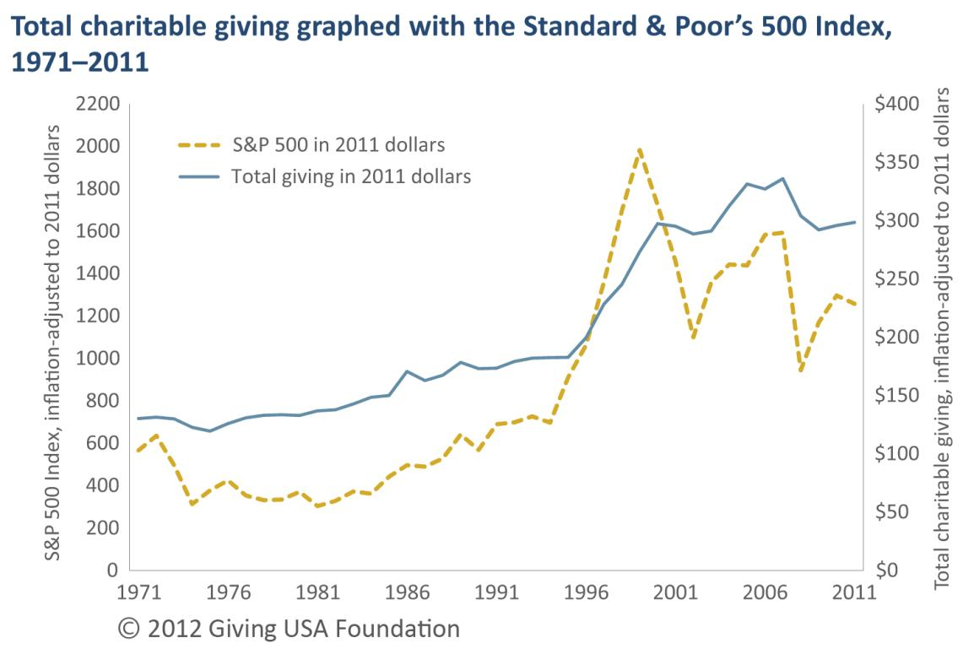
Total charitable giving graphed with the Standard & Poor's 500 Index, 1971-2011 (adjusted for inflation)
Source: Giving USA Foundation™/GIVING USA 2012
Notes:
Research has found a statistically significant correlation between changes in total giving and values on the Standard & Poor’s 500 Index (S&P 500). Because stock market values are an indicator of financial and economic security, individuals are more likely to give when the stock market is up.²⁴
The S&P 500 declined 3 percent in inflation-adjusted dollars (or inflation-adjusted dollars) between 2010 and 2011. This is compared with an increase of 10.9 percent between 2009 and 2010, and growth of 23.8 percent between 2008 and 2009.²⁵
• Note that when graphed together, giving does not rise as quickly as the Standard & Poor’s 500 Index, nor does it fall as steeply when the Index declinesResearch has found a statistically significant correlation between changes in total giving and values on the Standard & Poor’s 500 Index (S&P 500). Because stock market values are an indicator of financial and economic security, individuals are more likely to give when the stock market is up.
High-net-worth households, in particular, are responsive to changes in the stock market in terms of their charitable behavior. These households usually hold at least a portion of their assets in stocks.²⁴
The S&P 500 declined 3 percent in inflation-adjusted dollars (or inflation-adjusted dollars) between 2010 and 2011. This is compared with an increase of 10.9 percent between 2009 and 2010, and growth of 23.8 percent between 2008 and 2009.²⁵ The S&P 500 witnessed much larger increases and declines from year to year than total giving, and the direction of change for total giving usually lags the S&P 500 by one to two years.
Between 1971 and 1996, total giving was consistently higher than the S&P 500. This changed around 1997, when the S&P 500 rose sharply until 1999, after which it dropped precipitously through 2002. Increases in total giving lagged behind the S&P 500 during the index’s rise and leveled off during the index’s fall. Notably, despite the sharp declines in the S&P 500 between 1999 and 2002 (a drop of 44.5 percent), total giving either stayed level or dropped only slightly. When the S&P 500 fell 40.7 percent between 2007 and 2008, total giving dropped only 9.5 percent.
S&P and total giving move in the same direction.
S&P is more volatile that spikes with higher highs and lower lows, and is good that total giving is not as much otherwise it would be more difficult to predict.

Slide 14
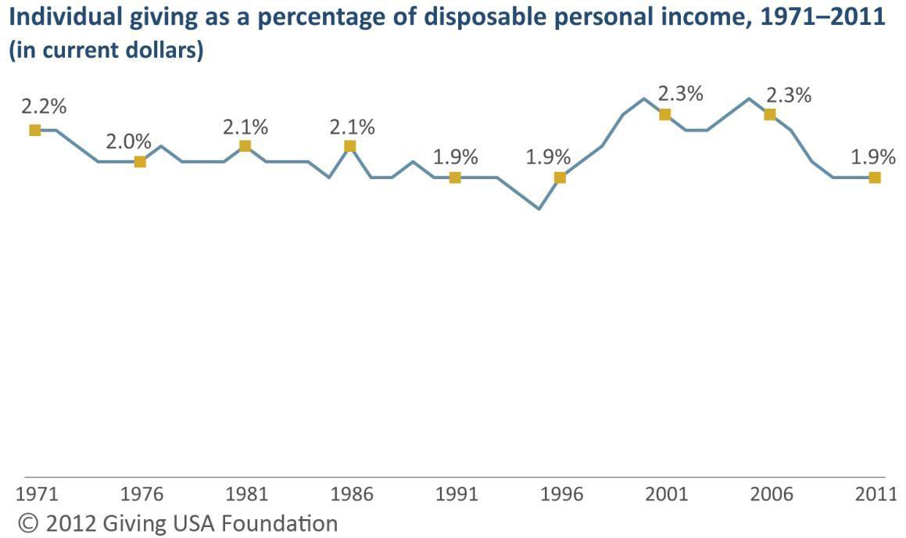
Individual giving as a share of disposable personal income, 1971–2011
Source: Giving USA Foundation™/GIVING USA 2012
Notes:
Disposable personal income (DPI) is the amount available to households after payment of taxes.
Individual giving in 2011 was an estimated 1.9 percent of DPI; the same percentage as in 2010.²⁶
• Individual giving as a percentage of DPI (in current dollars) remained at 1.9 percent in 2011, the same as in 2009 and 2010. This figure is a decline from the high of 2.4 percent realized in 2005 and remains below the 2.0 percent threshold seen between 1971–1984 and 1997–2008Disposable personal income is tied to (total) personal income—a key determinant in how much an individual or household gives. The amount that an individual gives is largely contingent on his or her income. However, for many individuals, how much they give depends on their spendable income (that is, disposable income, which is not tied to current expenses). In 2011, the increase in disposable personal income (in inflation-adjusted dollars) from 2010 was lower compared with the previous year, while the increase in personal income remained at the same level as the previous year.
In 2011, disposable personal income rose 3.8 percent from 2010, or 0.7 percent in inflation-adjusted dollars. This is compared with a 3.6 percent increase between 2009 and 2010, or 1.9 percent in inflation-adjusted dollars. In 2011, personal income grew 5.1 percent from 2010, or 2.0 percent in inflation-adjusted dollars. This is compared with an increase of 3.7 percent between 2009 and 2010, or 2.0 percent in inflation-adjusted dollars.²⁶
Individual giving as a percentage of disposable personal income (in current dollars) remained at 1.9 percent in 2011, the same as in 2009 and 2010. This figure is a decline from the high of 2.4 percent realized in 2005 and remains below the 2.0 percent threshold seen between 1971–1984 and 1997–2008.

Slide 15
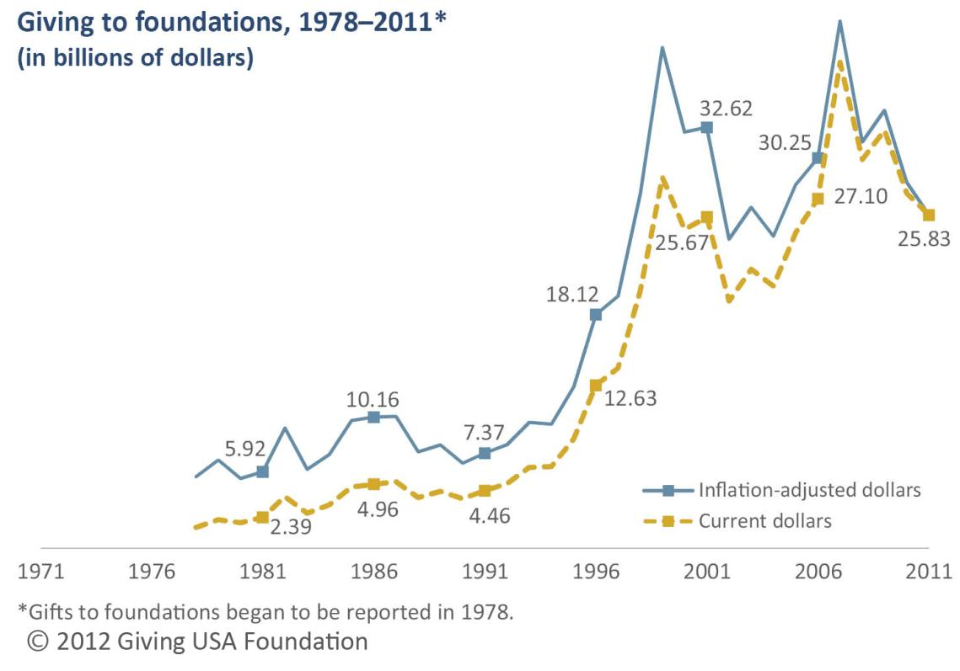
Giving to foundations, 1971–2011
Source: Giving USA Foundation™/GIVING USA 2012
Notes:
Foundation gifts received are estimated to be $25.83 billion in 2011.
Decrease of 6.1 percent (8.9 percent, adjusted for inflation)
9 percent of total giving in 2011
Giving USA’s findings include giving to private foundations, community foundations, and operating foundations. It does not include freestanding donor-advised funds, which are in the public-society benefit subsectorGiving to foundations is estimated to have declined by 6.1 percent in 2011 to $25.83 billion in contributions. Adjusted for inflation, giving to foundations is estimated to have declined by 8.9 percent. Foundations as recipient organizations comprise one of only two subsectors that realized a decline in giving in 2011.
The estimate for giving to foundations includes gifts made to independent, community, and operating foundations.
Giving USA does not count giving from corporations to their operating foundations since these gifts are transferred directly to individuals or nonprofit organizations. In 2011, Giving USA accounted for $3.75 billion estimated to have been transferred by pharmaceutical corporations to their operating foundations. The majority of these gifts are later paid directly to individuals in the form of in-kind donations of medications through Patient Assistance Programs (PAPs).
Over the last 33 years (1979–2011), inflation-adjusted giving to foundations has increased at a faster rate than the average annual rate of inflation (4.4 percent), with an average annual increase of 7.2 percent.
The only other subsector that showed a drop in giving in 2011 besides religion.
Does not include giving from corporations.

Slide 16
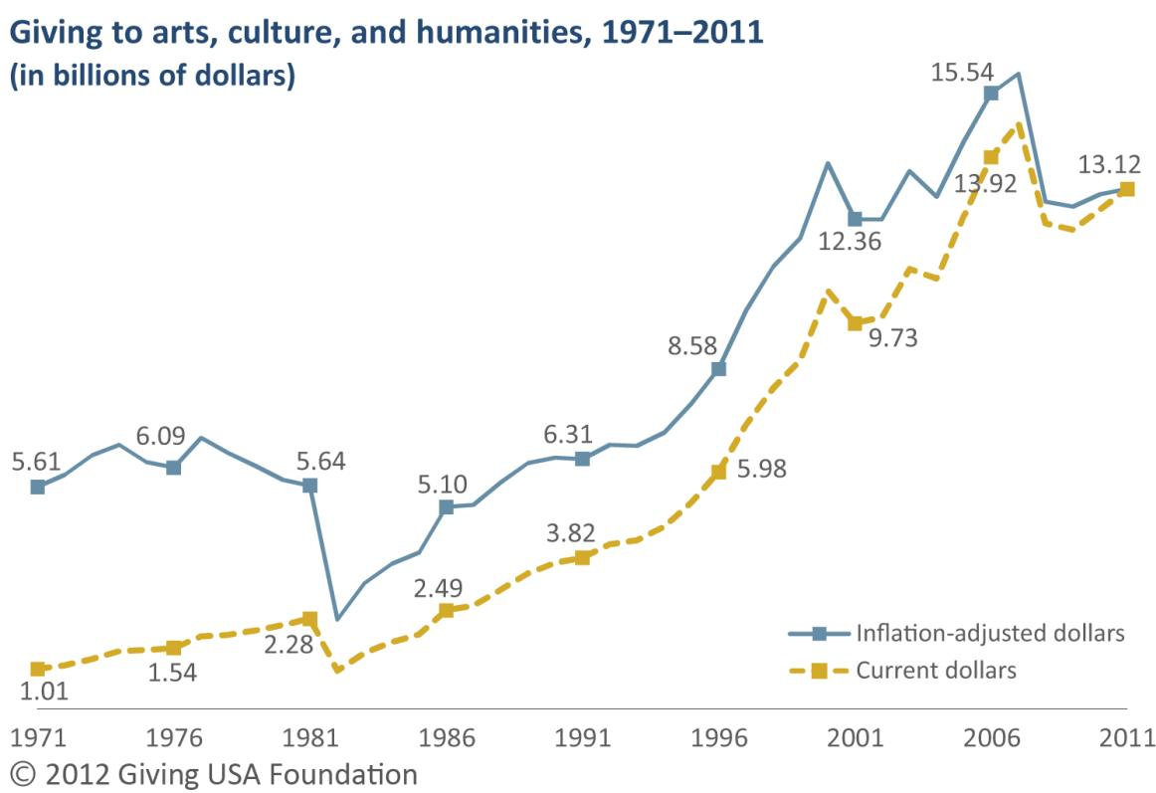
Giving to arts, culture, and humanities, 1971–2011
Source: Giving USA Foundation™/GIVING USA 2012
Notes:
Arts, culture, and humanities = $13.12 billion in 2011
• Increase of 4.1 percent (1.0 percent, adjusted for inflation)
• 4 percent of total estimated giving in 2011
• Bolstering giving to the arts subsector was an $800 million cash gift to Crystal Bridges Museum of American Art in Arkansas from the Walton Family Foundation.³³
Arts, culture, and humanities organizations engage in performance, exhibition, creation, teaching, and preservation of arts and cultural assets. They also include humanities organizations, historical societies, and public and nonprofit media organizationsCharitable giving to arts, culture, and humanities organizations is estimated to have increased 4.1 percent in 2011 from 2010, with $13.12 billion in total contributions.
Adjusted for inflation, giving to the arts, culture, and humanities subsector is estimated to have increased 1.0 percent.
Bolstering giving to the arts subsector was an $800 million cash gift to Crystal Bridges Museum of American Art in Arkansas from the Walton Family Foundation. This was the largest cash donation ever recorded to an art museum in the United States.³³
Over the last four decades (1971–2011), inflation-adjusted giving to the arts, culture, and humanities subsector has increased at a slightly faster rate than the average annual rate of inflation (4.4 percent), with average annual growth of 4.6 percent.

Slide 17
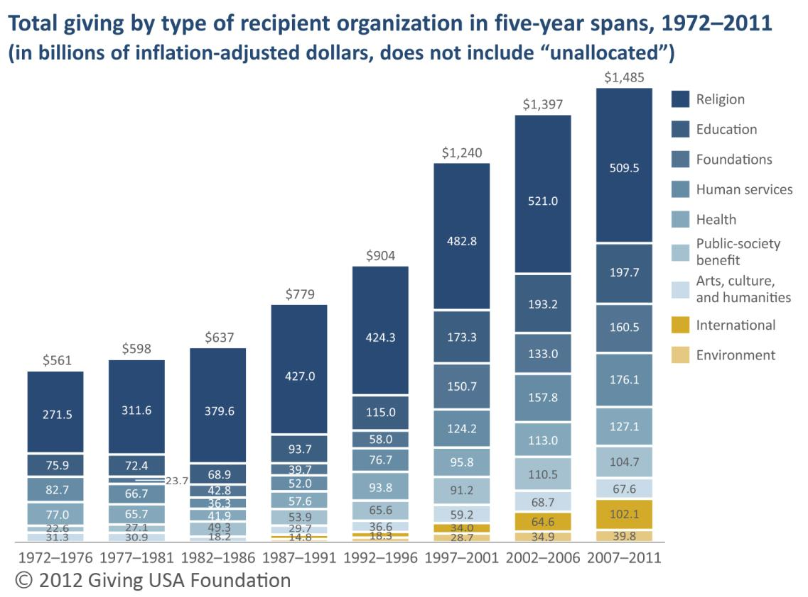
Total giving by type of recipient in five-year spans, 1972–2011
Source: Giving USA Foundation™/GIVING USA 2012
Notes:
After adjusting for inflation, giving to most types of charity in the 2007–2011 time-span exceeded the amount in the prior five years. The exceptions are charitable giving to religious organizations, public-society benefit organizations, and arts organizations.
• Giving to human services grew to an estimated $176.1 billion in the five years from 2007 through 2011, after totaling $157.8 billion in the prior five-year span.
Giving to educational organizations has slowed considerably since its peak in the 1997–2001 period. Total inflation-adjusted giving in the five-year periods beginning in 2002 and 2007 rose only 11.5 percent and 2.3 percent, respectively, from the previous five-year periods.
• Giving to health grew to an estimated $127.1 billion in the five years from 2007 through 2011, after totaling $113.0 billion in the prior five-year span.
Recently, giving to the environment/animals subsector has realized slower growth since its peak in the five-year period beginning in 1997, when it saw an increase in received contributions of 86.4 percent from the previous five-year period.
After adjusting for inflation, giving to almost every type of charitable organization in the 2007–2011 period exceeded the amount given in the prior five-year period. The exceptions are giving to religious organizations (a 2.2 percent decline), public-society benefit organizations (a 5.2 percent decline), and arts organizations (a 1.6 percent decline).
During the five-year periods beginning in 2002 and 2007, the international affairs subsector saw the largest increase in inflation-adjusted dollars received, at 58 percent.
Giving to educational organizations has slowed considerably since its peak in the 1997–2001 period. Total inflation-adjusted giving in the five-year periods beginning in 2002 and 2007 rose only 11.5 percent and 2.3 percent, respectively, from the previous five-year periods.
While giving to health has been on the rise since the five-year period beginning in 1987, giving to this subsector has slowed since its peak increase in the five-year period beginning in 1992, when contributed dollars rose 62.8 percent from the previous period.
Giving to the environment/animals subsector has also realized slower growth since its peak in the five-year period beginning in 1997, when it saw an increase in received contributions of 86.4 percent from the previous five-year period. In the five-year periods beginning in 2002 and 2007, giving to the environment/ animals subsector grew 21.6 percent and 14.0 percent, respectively.

Slide 18
Giving USA 2012 Executive Summary
Download the Giving USA 2012
free Executive Summary at
www.givingUSAreports.org
Source: Giving USA Foundation™/GIVING USA 2012

Slide 19
Ariley –Norton: “Building a Better America”

Slide 20
TrendsWatch 2013: Center for the Future of Museum
New Tax Policies
Wealth is More concentrated
50 wealthiest donors gave more than $10 billion
½ of giving comes from top 3%
Middle class gives more of a % of own worth
Boomers will soon control 70% of wealth and less generous than parents
Women give more (by 89%) after age 50
Racial and ethnic diversity
Millennials demand more proof of effectiveness
Outcome-oriented Philanthropy

Slide 21
15,123

Slide 22
BIG $$$

Slide 23
THANK YOU
Q&A

