Slide 1
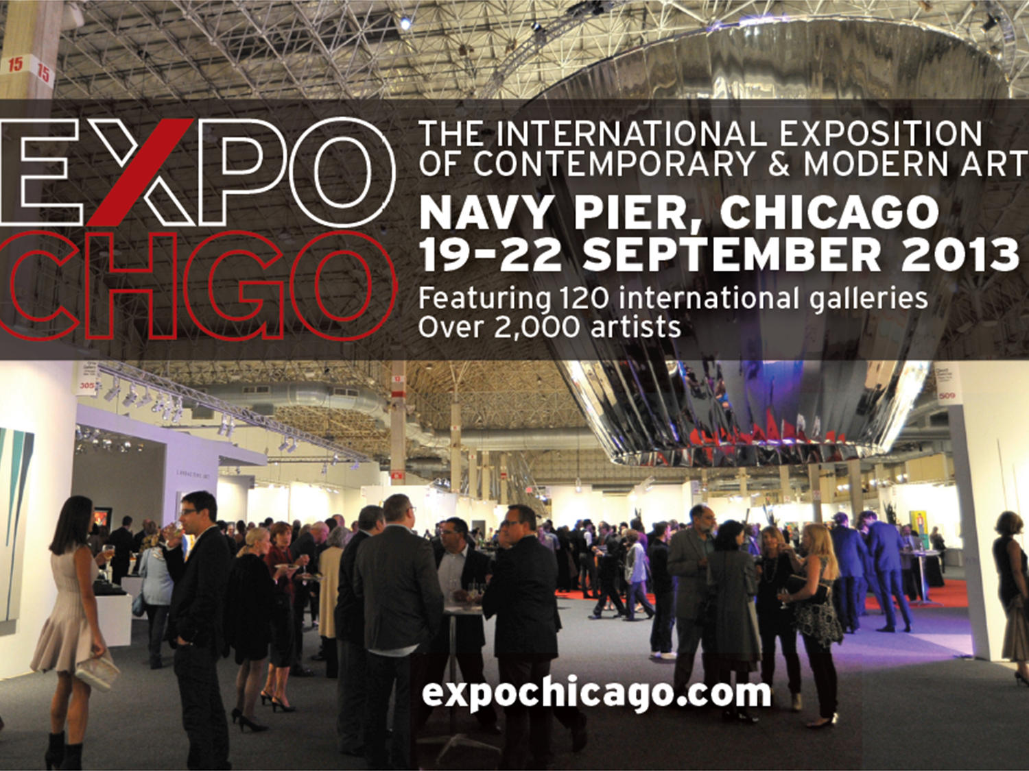

Slide 2
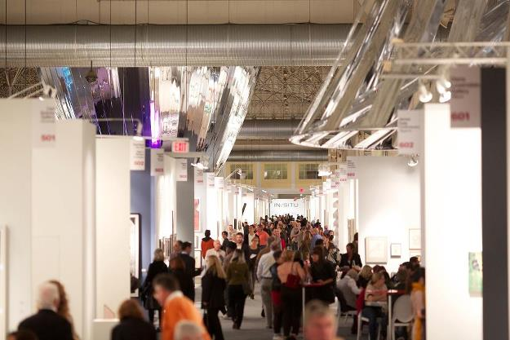
2012 OVERVIEW
The inaugural EXPO CHICAGO, The International Exposition of Contemporary and Modern Art, hosted an exclusive list of the world's 120 premier galleries in Chicago September 20–23 at Navy Pier.
The new fair opened the international fall arts season and has come to establish Chicago as a preeminent art fair and cultural destination.
In addition to the Fair itself, EXPO CHICAGO and the Museum of Contemporary Art Chicago opened the fair with the return of Vernissage, an exclusive benefit preview celebration. A highlight of the city’s social and cultural calendar, Vernissage offers first viewing of the fair, with all proceeds benefiting the Museum of Contemporary Art Chicago.
Total Attendance: 27,000
Vernissage Attendance: 3,000

