Slide 1
AMDA Salary, Training, Bonus & Retention Survey A Presentation At AMDA 2013 Chicago
Lynne LaMarca Heinrich | Senior Consultant & Principal
Penny Hunt | Senior Consultant
Devin Matias | Consultant
May 2013

Slide 2
AMDA Salary Survey - Goals:
Salaries for museum development staff with the capability to analyze by:
Type and geographic region
Institutional revenue and expense
Campaign status
Full ranges and averages
Challenges and successful tactics in retaining staff
Variations in bonus pay structures and training programs
Issues of importance, related to job satisfaction, for Chief Development Officers

Slide 3
Methodology
The total survey response rate of 29.9%, is significantly higher than our average survey response rate.
49 completed surveys – from 44 members and 5 potential members.
Invitations were deployed to 178 email addresses, with a bounce rate of 6.2% (11 emails).

Slide 4
Methodology
Participants, by museum type:

Slide 5
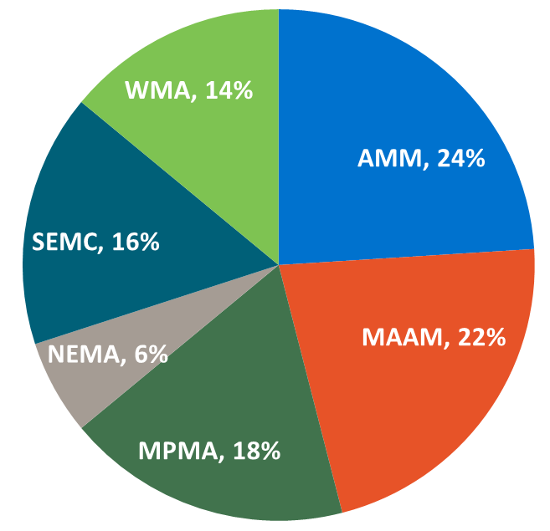
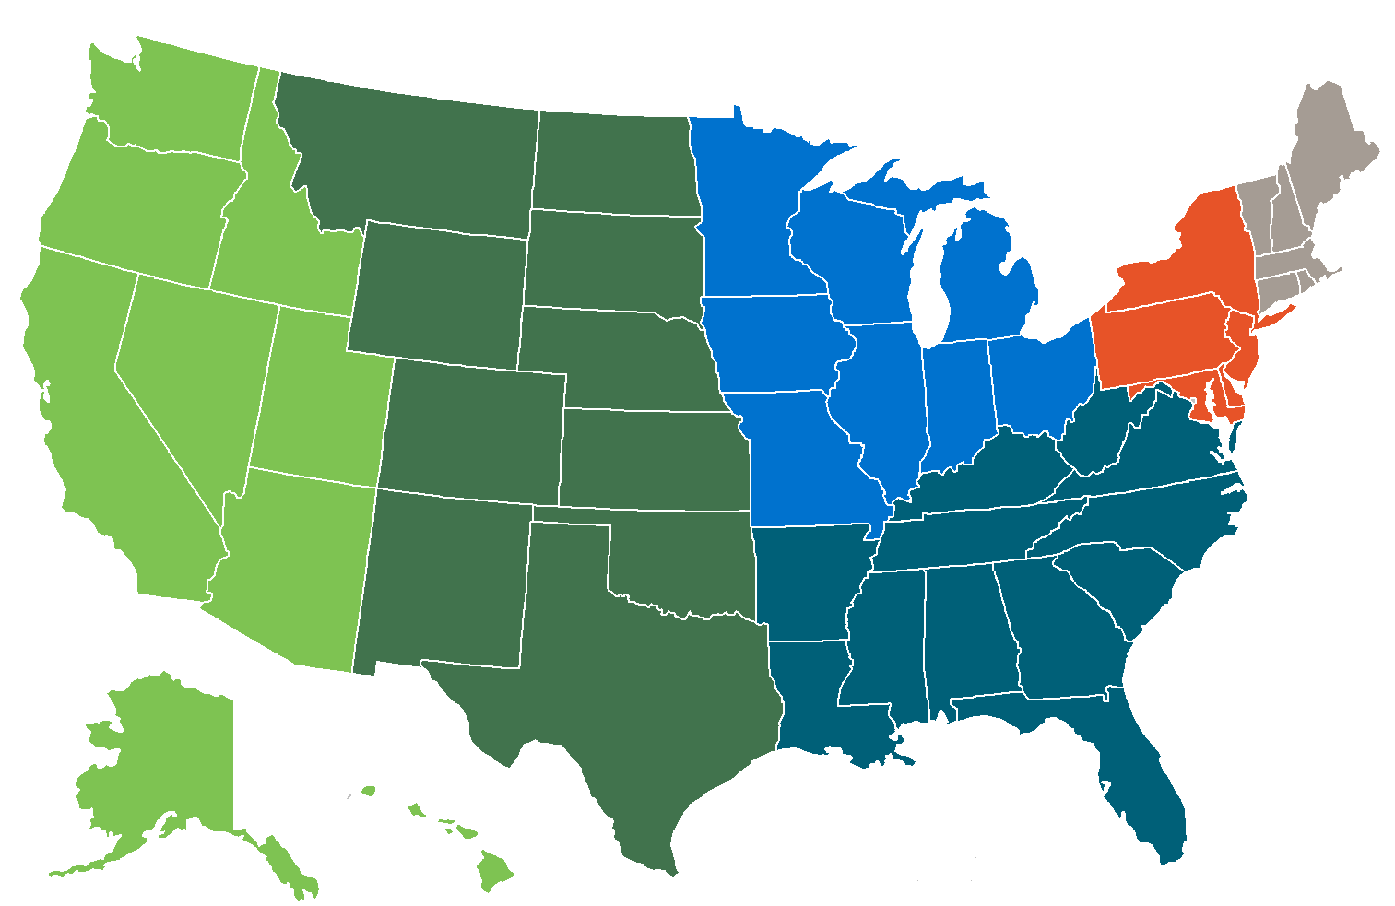
Methodology
Participants, by region:
Association of Midwest Museums (AMM) New England Museum Association (NEMA)
Mid-Atlantic Association of Museums (MAAM) Southeastern Museums Conference (SEMC)
Mountain Plains Museums Association (MPMA) Western Museums Association (WMA)

Slide 6
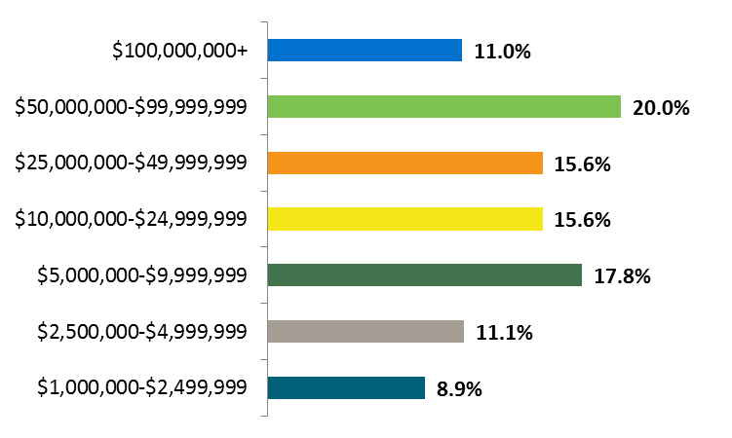
Methodology
Participants, by total revenue:

Slide 7
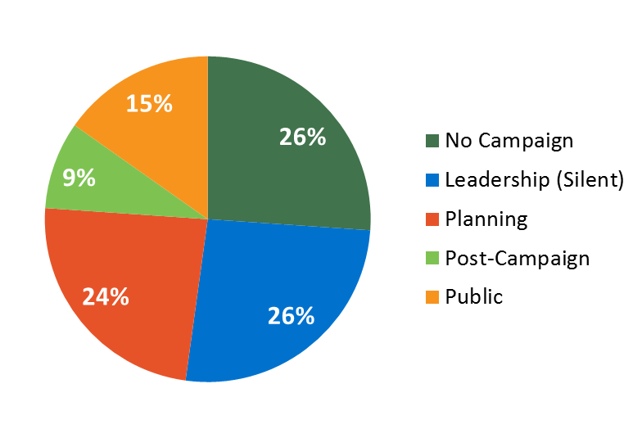
Methodology
Participants, by campaign status:
65% of participants are actively planning or managing a capital campaign

Slide 8
Participants
Akron Art Museum
The Barnes Foundation
Blanton Museum of Art
University of Texas, Austin
Brooklyn Museum
The Cleveland Museum of Art
Columbia Museum of Art
The Columbus Museum of Art
Crystal Bridges Museum of American Art
Davis Museum
Wellesley College
Dayton Art Institute
Eli and Edythe Broad Art Museum
Michigan State University
Florence Griswold Museum
Hammer Museum
UCLA
Harn Museum of Art
University of Florida
High Museum of Art
Hunter Museum of American Art
Indianapolis Museum of Art
The J. Paul Getty Trust
Joslyn Art Museum
LACMA
Madison Museum of Contemporary Art
McNay Art Museum
Michael C. Carlos Museum
Emory University
Museum of Contemporary Art, Chicago
Museum of Contemporary Art, Denver

Slide 9
Participants
The Museum of Fine Arts, Houston
Museum of New Mexico Foundation
The Nasher Museum of Art
Duke University
National Museum of Women in the Arts
New Museum
The Noguchi Museum
Peabody Essex Museum
Philadelphia Museum of Art
Philip and Muriel Berman Museum of Art
Ursinus College
The Renaissance Society
Saint Louis Art Museum
Seattle Art Museum
Smart Museum of Art
University of Chicago
Spencer Museum of Art
University of Kansas
University of Michigan Museum of Art
Utah Museum of Fine Arts
Vancouver Art Gallery
Vero Beach Museum of Art
Virginia Museum of Fine Arts
Walker Art Center
The Walters Art Museum
Whitney Museum of American Art
Yale Center for British Art
Yale University Art Gallery

Slide 10
Salary Comparisons: Chief Development Officers

Slide 11
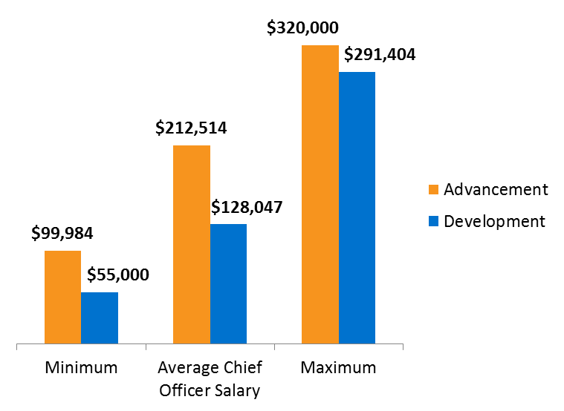
Advancement vs. Development
Average drop-off from top salary to second-highest: 40%
Average drop-off from top salary to third-highest: 55%

Slide 12
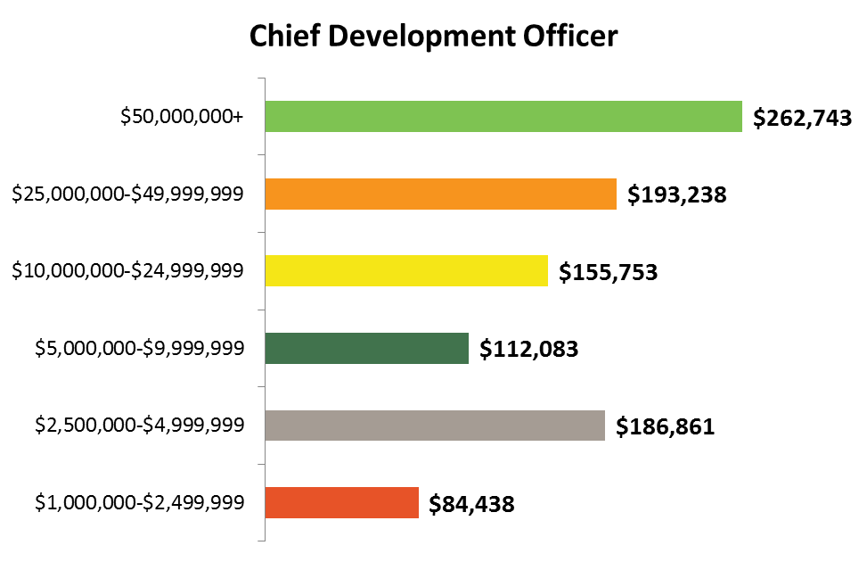
Average Salaries by Museum Revenue
Range
$197,000 - $320,000
$114,785 - $291,404
$128,750 - $180,000
$63,000 - $162,000
$62,500 - $90,000
$55,000 - $98,500

Slide 13
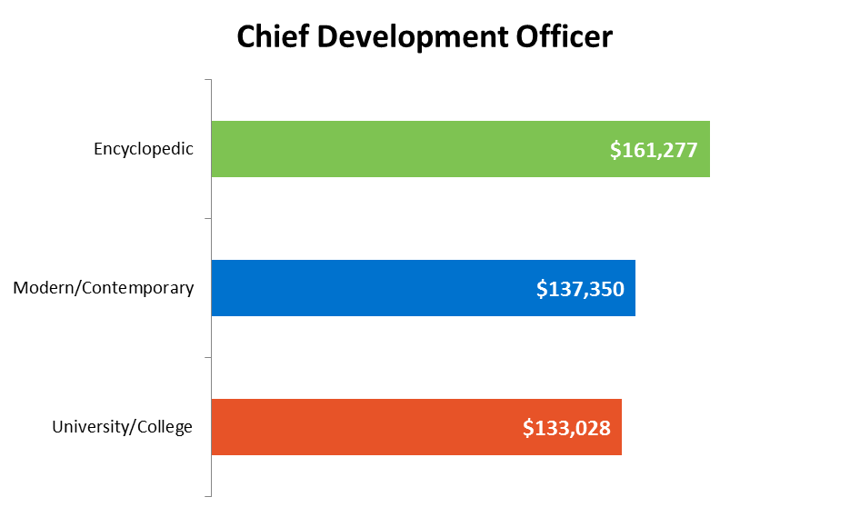
Average Salaries by Museum Type
Range
$62,500
- $320,000
$55,000 - $291,404
$56,000 - $250,000

Slide 14
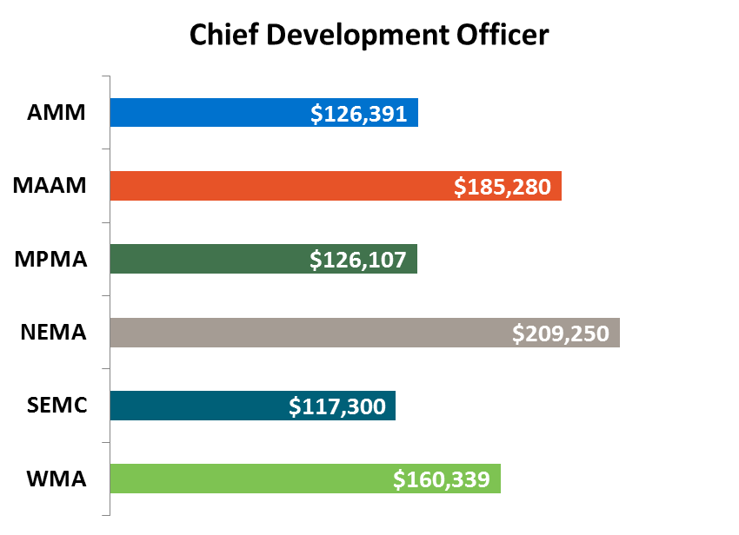
Average Salaries by Region
Association of Midwest Museums (AMM) New England Museum Association (NEMA)
Mid-Atlantic Association of Museums (MAAM) Southeastern Museums Conference (SEMC)
Mountain Plains Museums Association (MPMA) Western Museums Association (WMA)

Slide 15
Chief Development Officers: Overall Job Satisfaction

Slide 16
CDO Responses: Job Satisfaction 47 of 49 Respondents
Level of Board Involvement in Fundraising
“Moderately Involved” = 32
“Not Involved” = 7
“Very Involved” = 5
“NA” = 3
Largest Source of Stress
Long hours, unrealistic expectations
No pay raises
Building a culture of philanthropy – Board, Director
Pull between day to day management and front line fundraising

Slide 17
CDO Responses: Job Satisfaction, continued
How to Improve Job Satisfaction?
Right-sized job responsibilities
Realistic expectations
Clarity around mission, priorities
Stronger Director and Board leadership
“Better pay” = #2

Slide 18
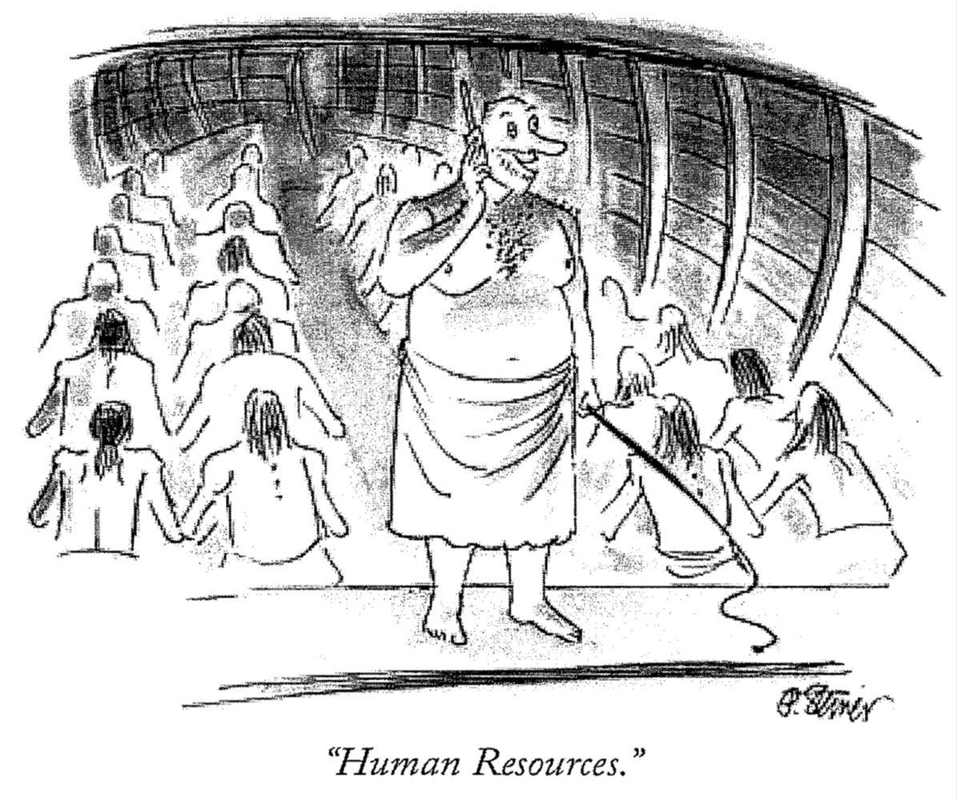
Talent Development

Slide 19
Strategic Talent Development

Slide 20
Who should we be developing?
Creating team vs. singling out stars
Defining truly stellar performance and potential
Public or privately identified?

Slide 21
Understanding star performers’ motivations
It’s not always money
Have you asked them?
Surveys
Reverse performance evaluation
Employee satisfaction committee
“Work/Life Balance”

Slide 22
Generational Differences
Paying dues?
Role of work in overall lifestyle
Job serves employee, not vice versa

Slide 23
Incentives – Financial and Non-Financial
Know your market
Incentive plans
What has value, but not a price?
Enlist your colleagues
The significance of quarter points

Slide 24
Individual Professional Development Plans

Slide 25
Using the donor life cycle
Identification
Who might we solicit?
Who would we like to retain?
Qualification
Who might give?
Who would stay?

Slide 26
Using the donor life cycle
Cultivation
Working together to create meaningful engagement
Working together to plan meaningful future
Solicitation
Committing to the project
Committing to the partnership

Slide 27
Using the donor life cycle
Stewardship
Continued commitment to implementation
Continued commitment to implementation

Slide 28
Your Own Path

