Slide 1
A STUDY BY:
A JOINT INITIATIVE OF:
GENEROUSLY SUPPORTED BY:
The Andrew W. Mellon Foundation, The Kresge Foundation, The John D.and Catherine T. MacArthur Foundation, The Rockefeller Brothers Fund
Notes:
JOANNA

Slide 2
RESEARCH TEAM
Joanna Woronkowicz, Cultural Policy Center, University of Chicago
Carroll Joynes, Cultural Policy Center, University of Chicago
Peter Frumkin, School of Social Policy and Practice, University of Pennsylvania
Ana Kolendo, RGK Center for Philanthropy and Community Service, University of Texas at Austin
Robert Gertner, Booth School of Business, University of Chicago
Bruce Seaman, Andrew Young School of Policy Studies, Georgia State University
Norman Bradburn, NORC at the University of Chicago
Notes:
JOANNA
-stress the range of disciplines and competencies and their extensive experience

Slide 3
AUDIENCE AND GOALS
Establish the project report as a fundamental reference for any
cultural organization in the country planning construction, renovation,
or expansion.
Establish a long-term resource for scholars doing work in cultural
policy by making data we collected available to the general community
of researchers.
Provide guidance to executive officers having conversations with potential funders about initiating and completing successful building projects.
Make the report (and its authors) automatic points of reference
for governmental leaders and foundations considering support
for cultural institutions.
Notes:
JOANNA + CARROLL

Slide 4
RESOURCES FOR ORGANIZATIONS culturalpolicy.uchicago.edu/setinstone
Full academic report
Two-page graphical overview
Four case studies
Two instructional videos
Virtual bookshelf of related reading materials
Data in NORC Data Enclave
Forthcoming: two books being published by the University of Chicago Press
Notes:
JOANNA + CARROLL

Slide 5
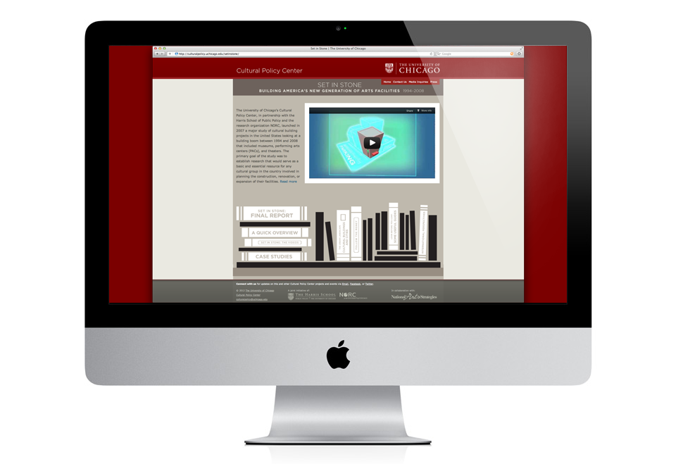

Slide 6
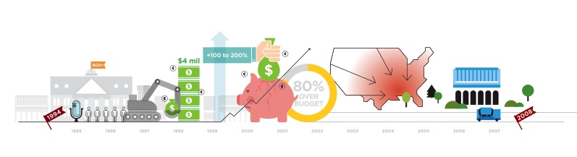
PROJECT GENESIS
View from the nonprofit arts sector
• Substantial investments into bricks and mortar
• Similar challenges among nonprofit arts organizations engaged in building
• Need for a study to induce data-informed decision-making
Notes:
CARROLL

Slide 7
THE STUDY
Project Parameters
• Museums, theaters, and performing arts centers
• New construction and renovations
• 1994 to 2008
Methodology
• Assembled a census of all cultural building projects
• Chose a random sample of 56 projects for in-depth study
• Interviewed organizations in project communities to examine spill-over effects
• Developed case studies
Notes:
JOANNA
-describe the definition of a museum
-data were confidential
-memories decline before 1994

Slide 8
RESEARCH QUESTIONS
• What was the extent of building in the cultural sector?
• Why did cities and organizations invest in building?
• What were the characteristics of successful projects?
• What was the impact of building on communities?
Notes:
JOANNA

Slide 9
THE LANDSCAPE OF CULTURAL BUILDING
There was a substantial increase in cultural facilities building, particularly between 1998 and 2001, the “building boom.”
Notes:
CARROLL

Slide 10
THE LANDSCAPE OF CULTURAL BUILDING
There was a substantial increase in cultural facilities building, particularly between 1998 and 2001, the “building boom.”
Notes:
CARROLL

Slide 11
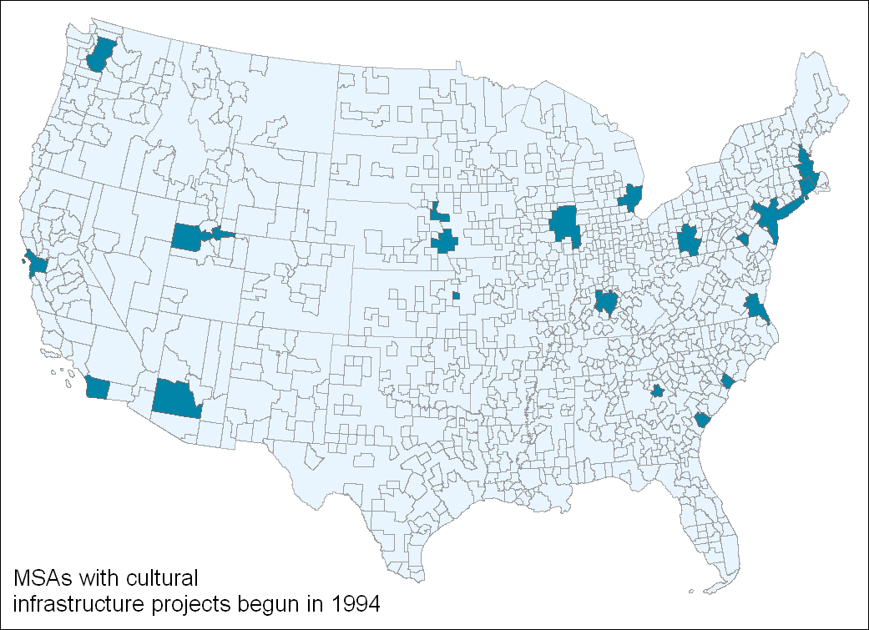
THE LANDSCAPE OF CULTURAL BUILDING
Notes:
JOANNA

Slide 12
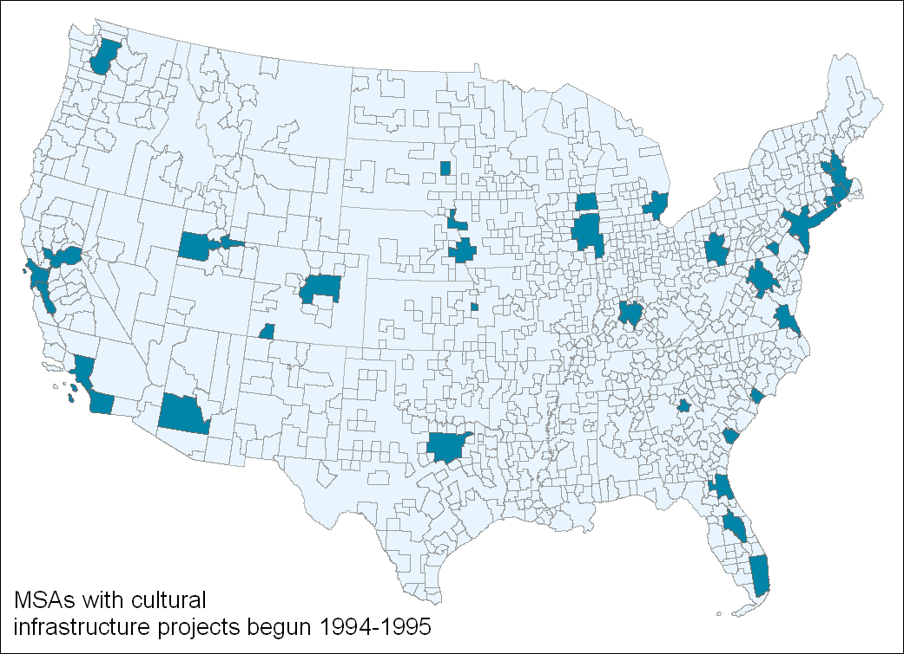
THE LANDSCAPE OF CULTURAL BUILDING

Slide 13
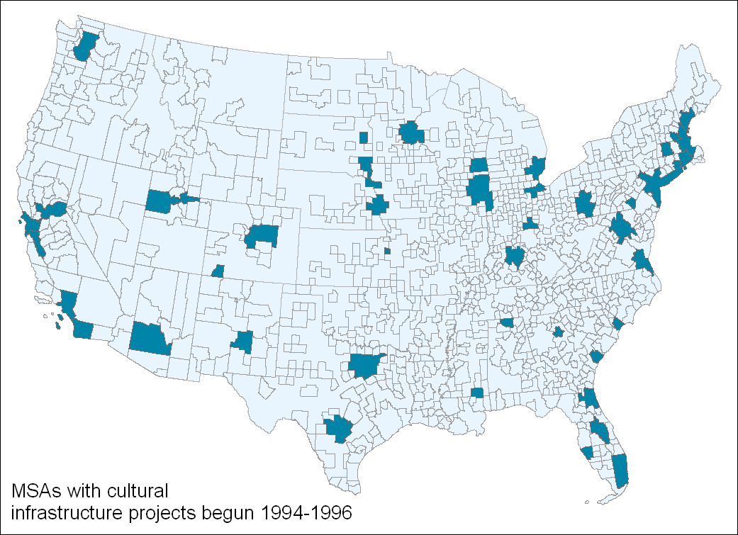
THE LANDSCAPE OF CULTURAL BUILDING

Slide 14
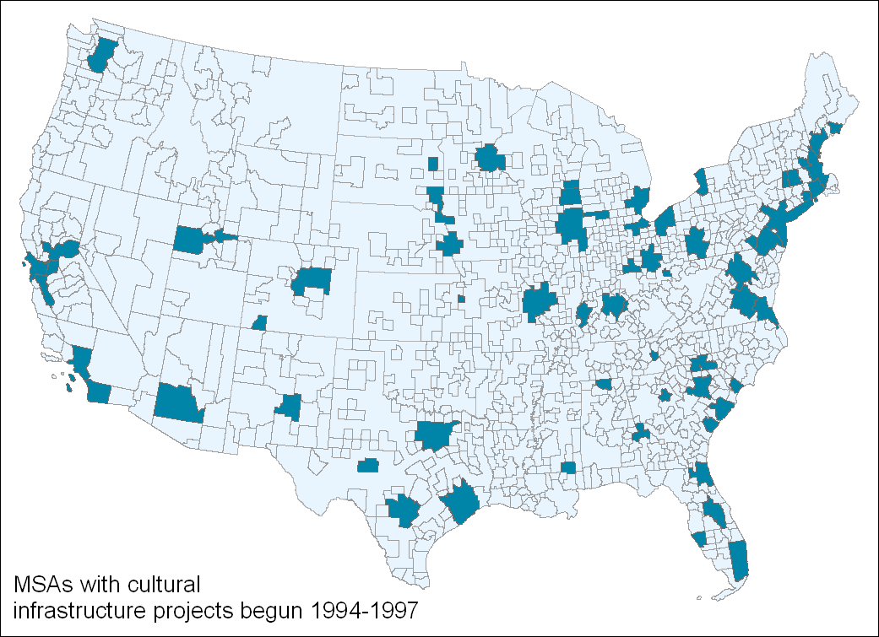
THE LANDSCAPE OF CULTURAL BUILDING

Slide 15
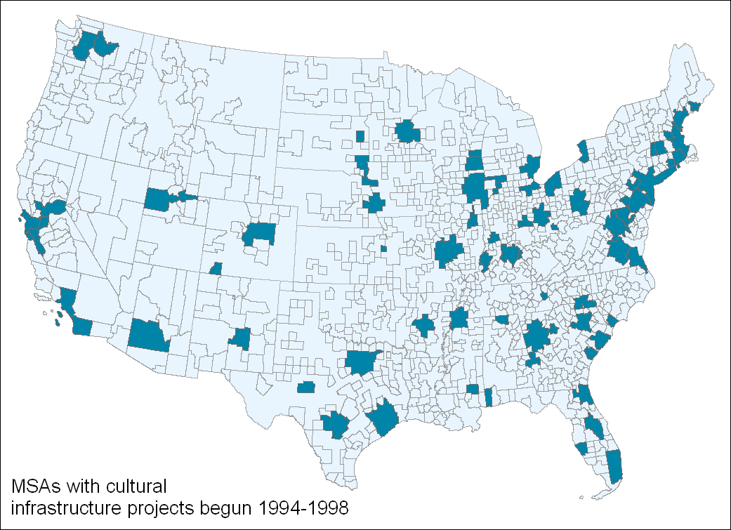
THE LANDSCAPE OF CULTURAL BUILDING

Slide 16
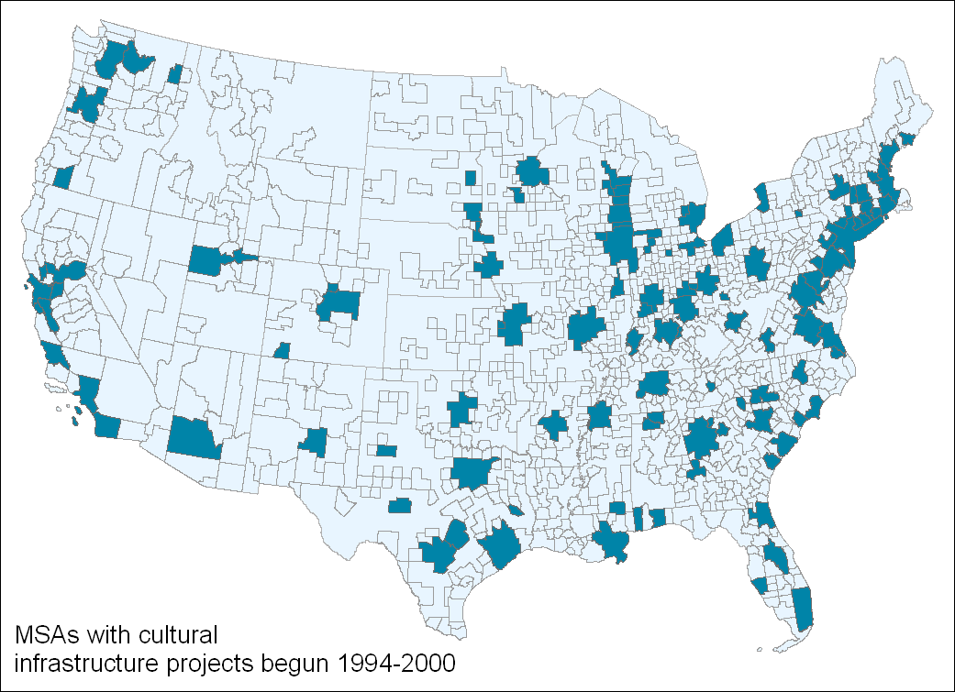
THE LANDSCAPE OF CULTURAL BUILDING

Slide 17
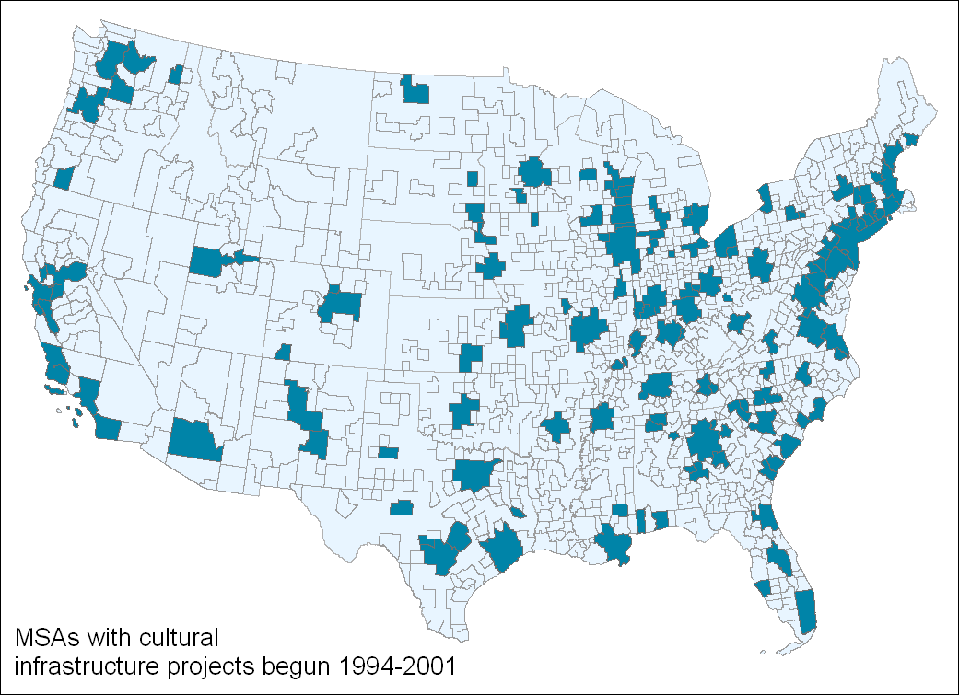
THE LANDSCAPE OF CULTURAL BUILDING

Slide 18
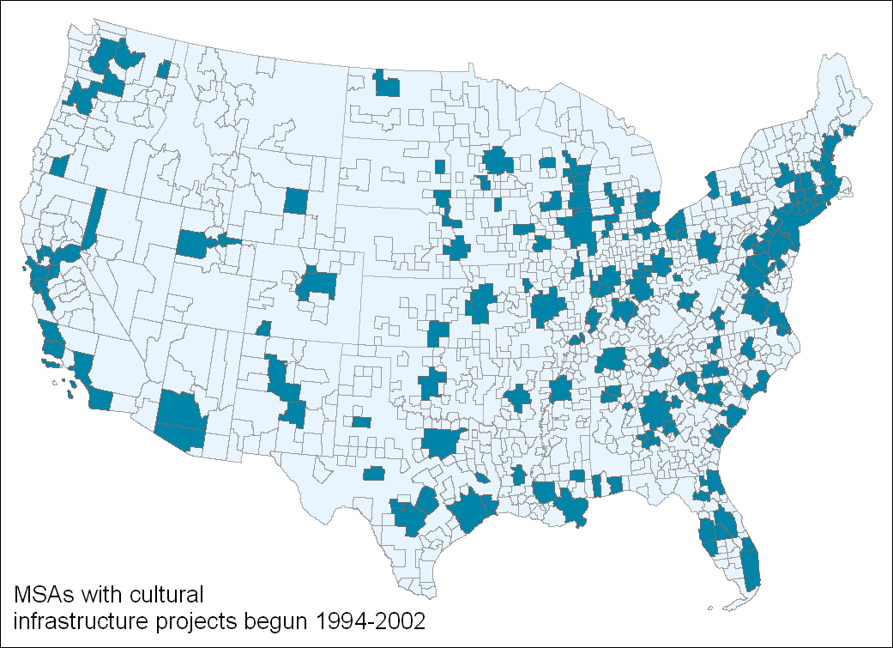
THE LANDSCAPE OF CULTURAL BUILDING

Slide 19

THE LANDSCAPE OF CULTURAL BUILDING

Slide 20
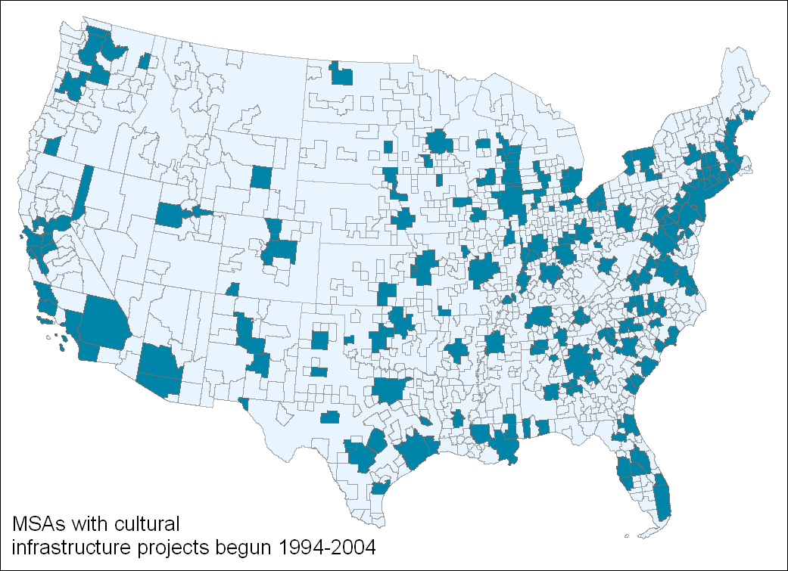
THE LANDSCAPE OF CULTURAL BUILDING

Slide 21
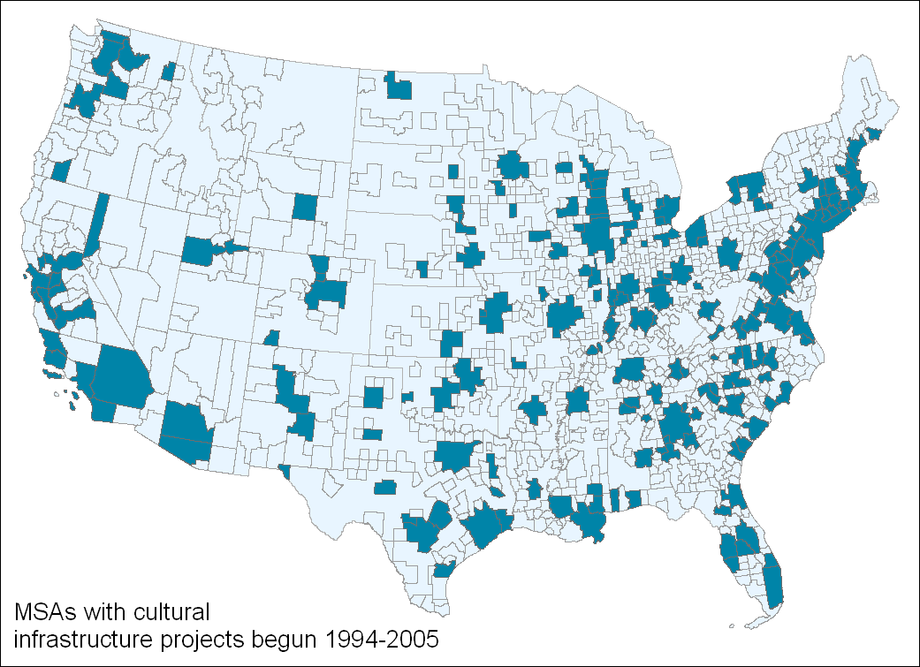
THE LANDSCAPE OF CULTURAL BUILDING

Slide 22
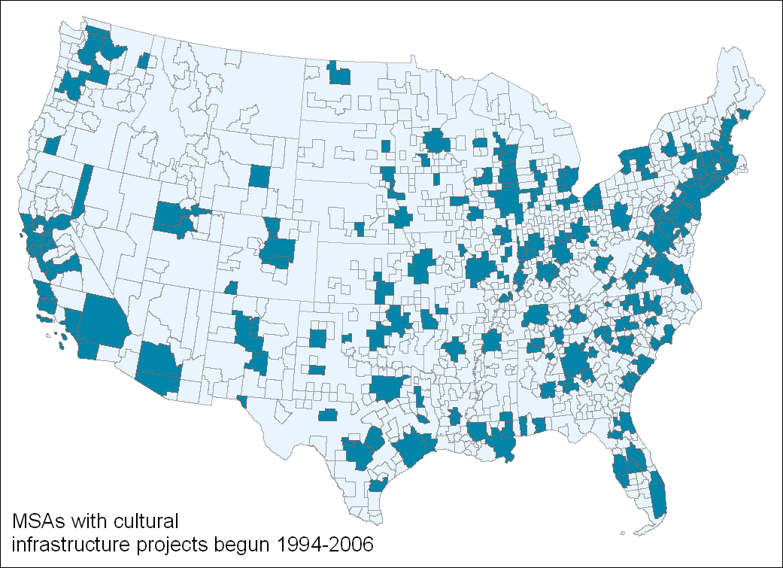
THE LANDSCAPE OF CULTURAL BUILDING

Slide 23
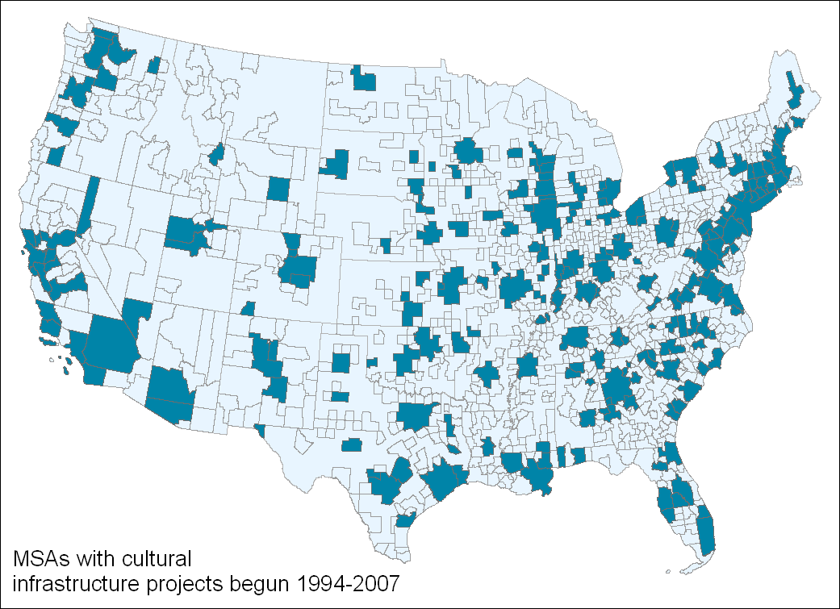
THE LANDSCAPE OF CULTURAL BUILDING

Slide 24

THE LANDSCAPE OF CULTURAL BUILDING

Slide 25
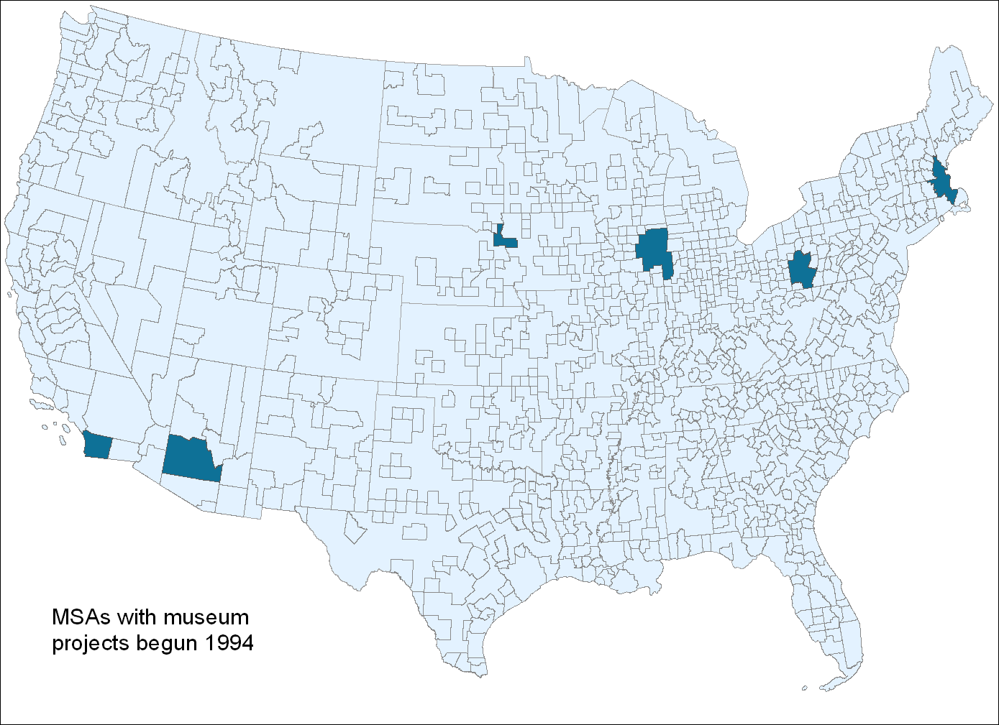
THE LANDSCAPE OF CULTURAL BUILDING
Notes:
CARROLL

Slide 26
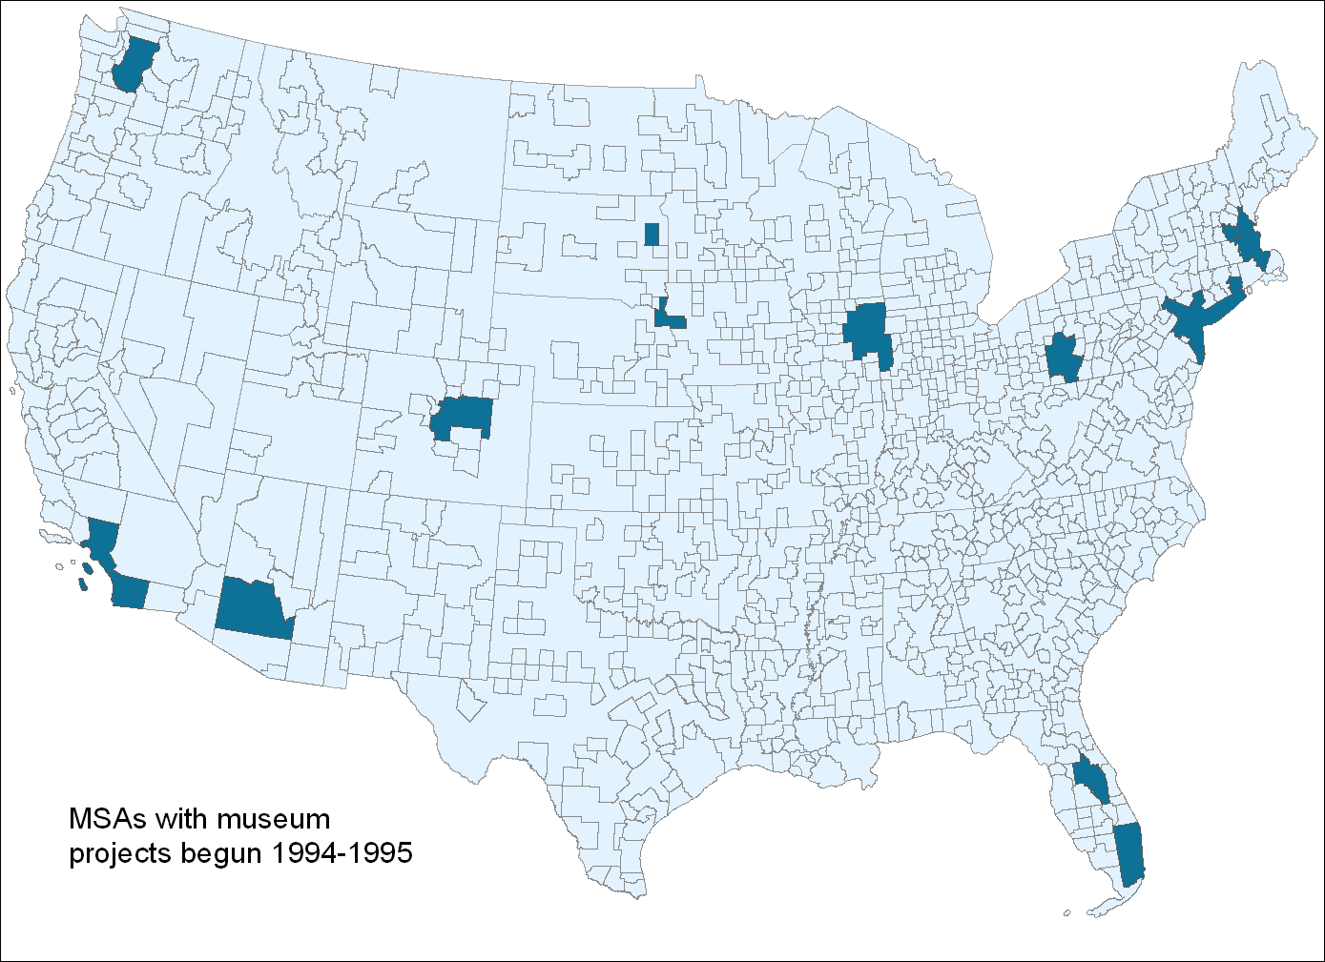
THE LANDSCAPE OF CULTURAL BUILDING

Slide 27
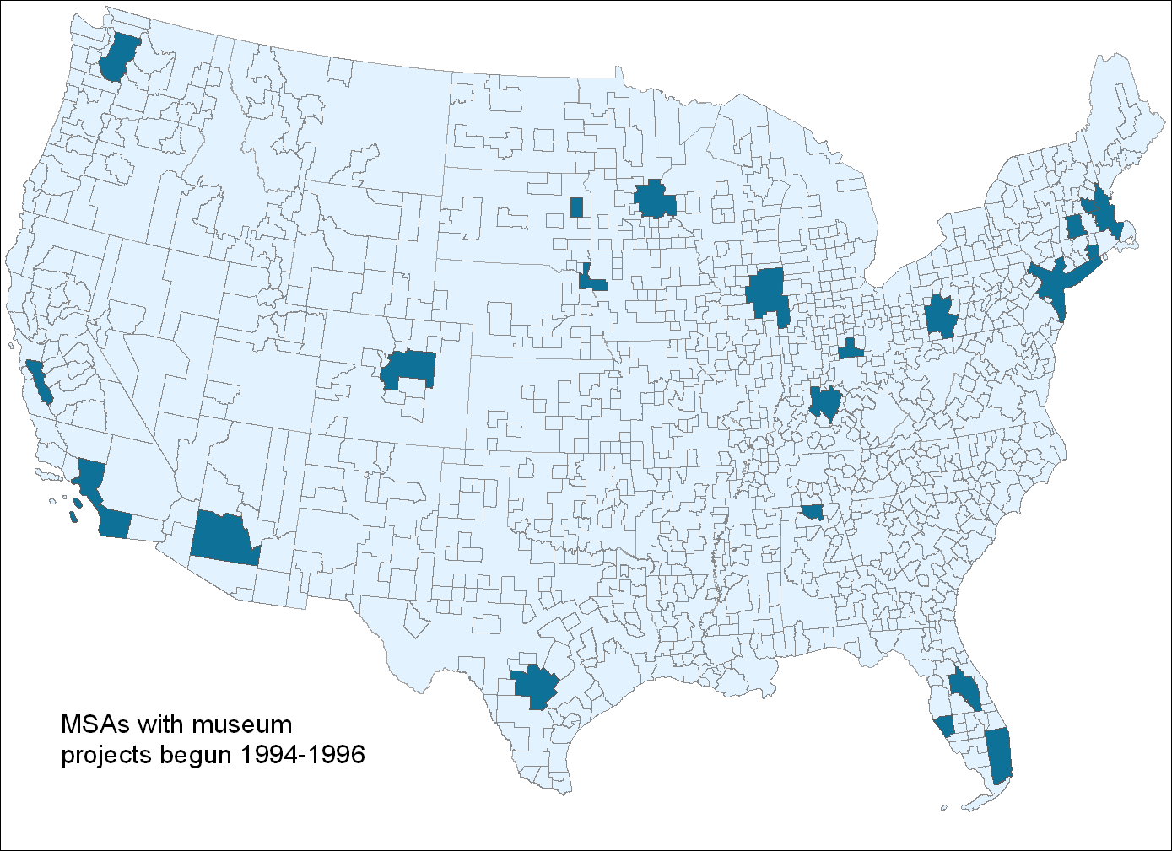
THE LANDSCAPE OF CULTURAL BUILDING

Slide 28
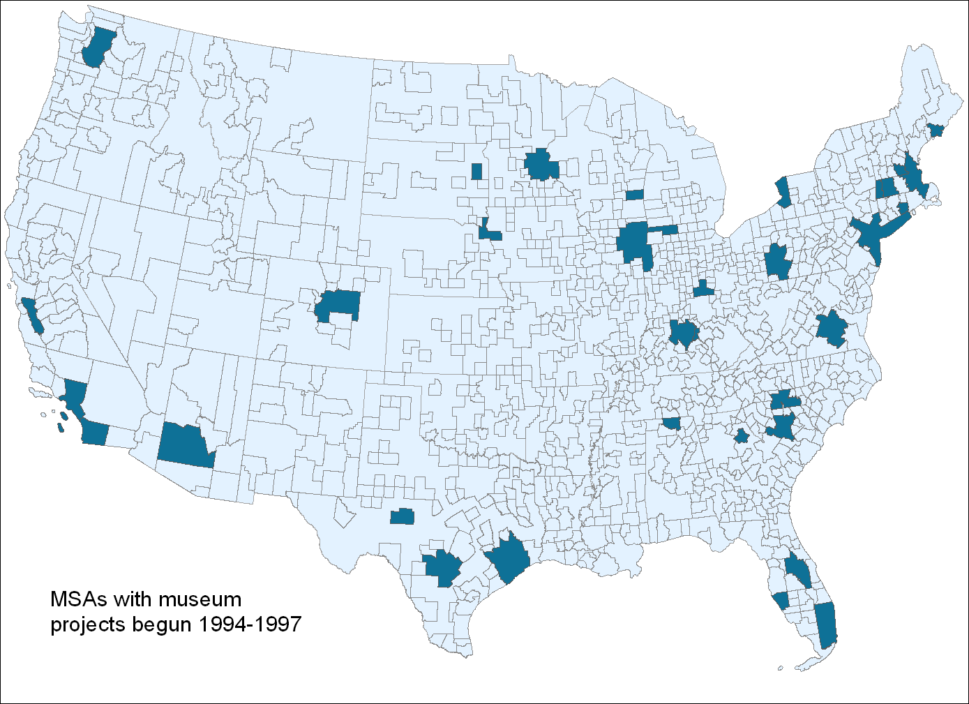
THE LANDSCAPE OF CULTURAL BUILDING

Slide 29
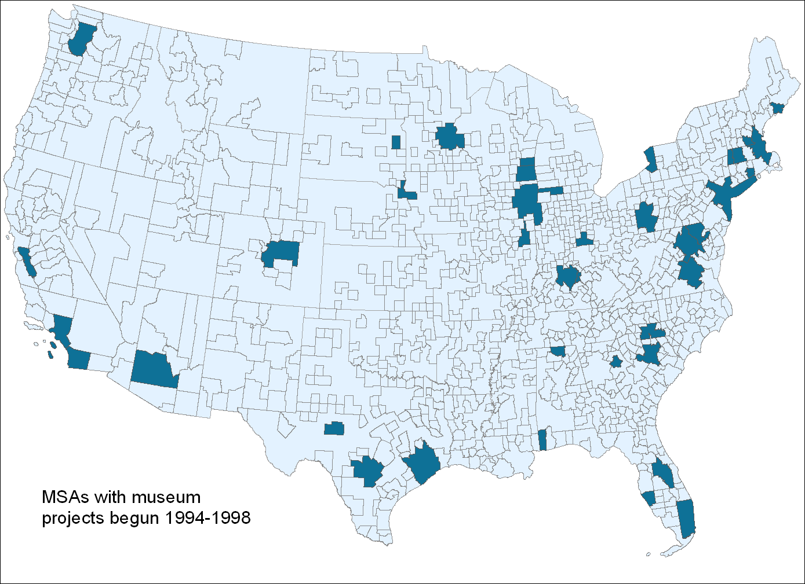
THE LANDSCAPE OF CULTURAL BUILDING

Slide 30
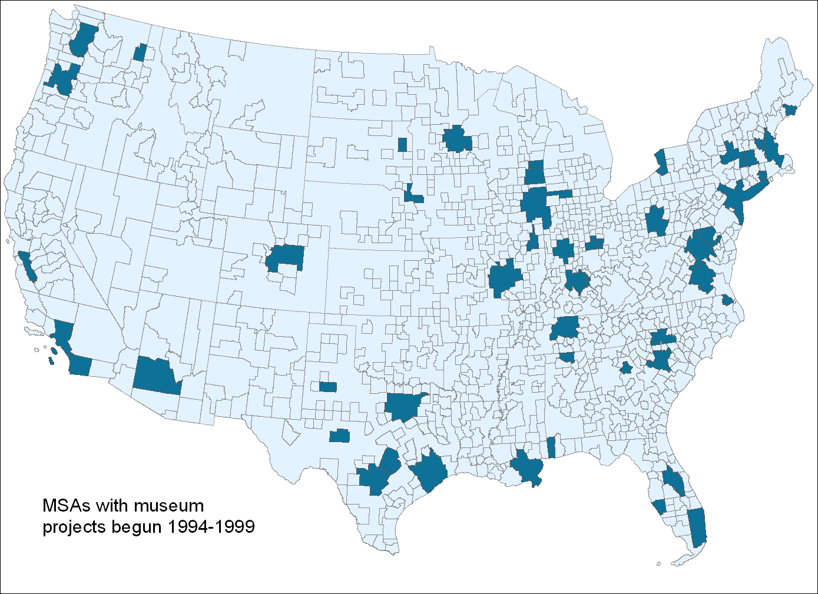
THE LANDSCAPE OF CULTURAL BUILDING

Slide 31
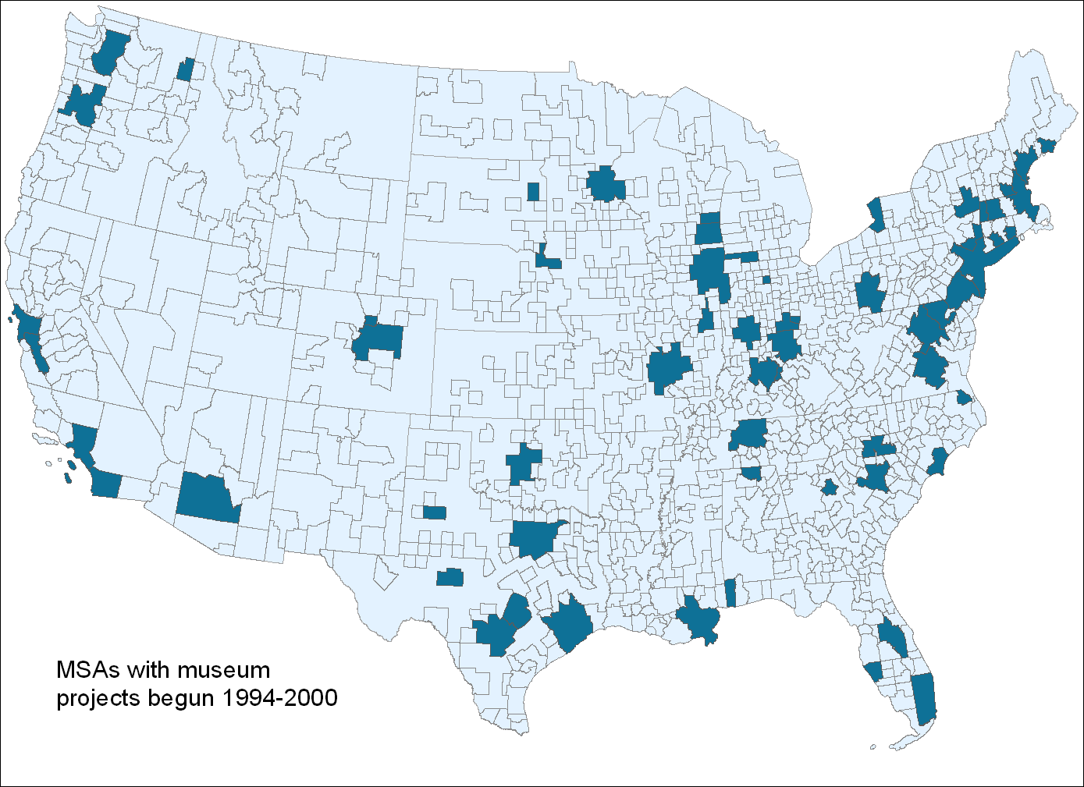
THE LANDSCAPE OF CULTURAL BUILDING

Slide 32
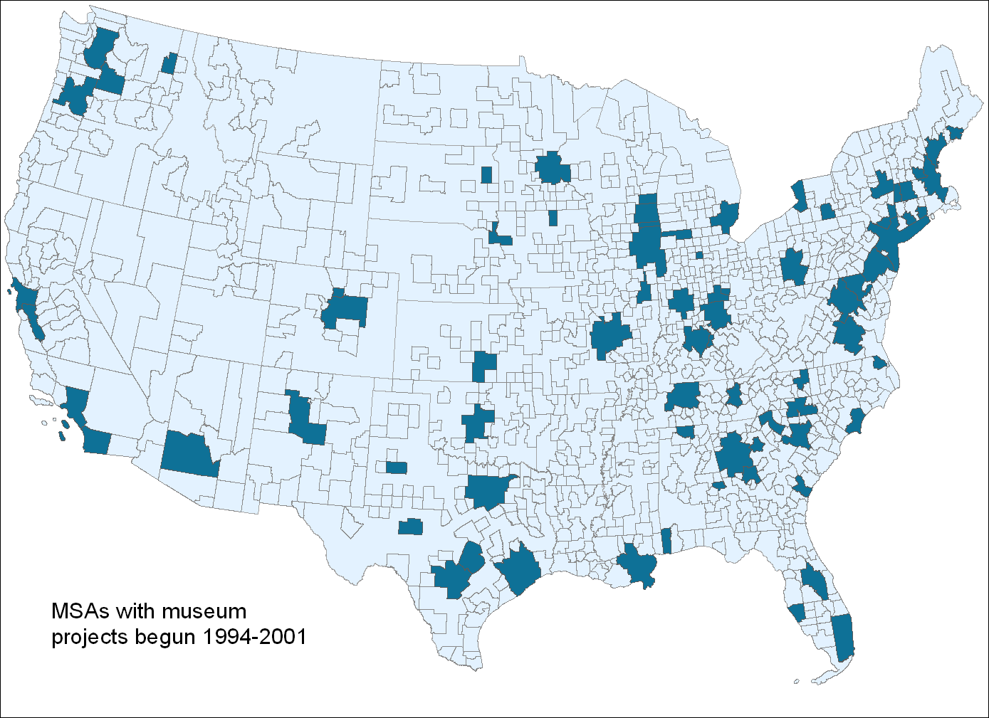
THE LANDSCAPE OF CULTURAL BUILDING

Slide 33
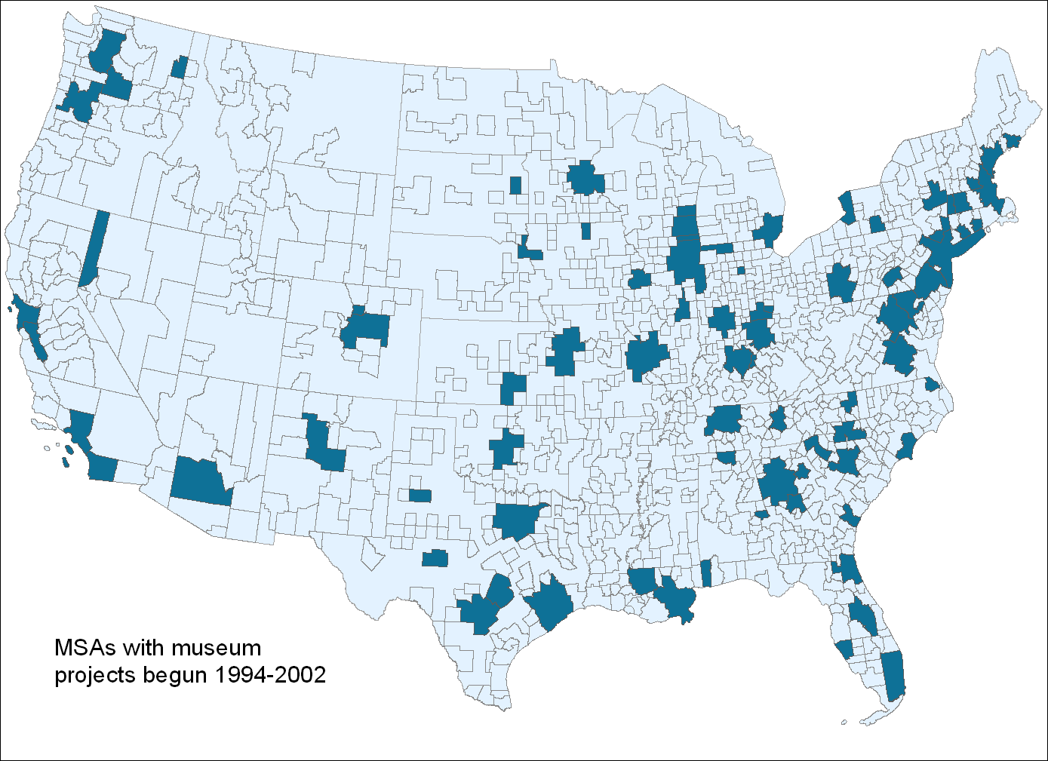
THE LANDSCAPE OF CULTURAL BUILDING

Slide 34
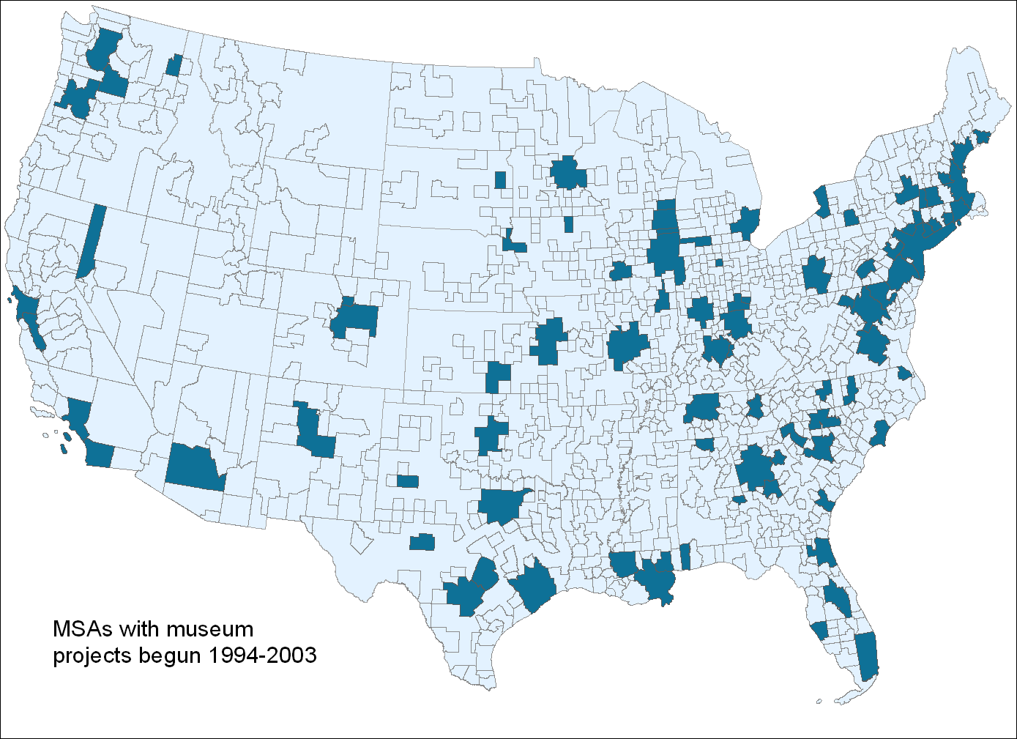
THE LANDSCAPE OF CULTURAL BUILDING

Slide 35
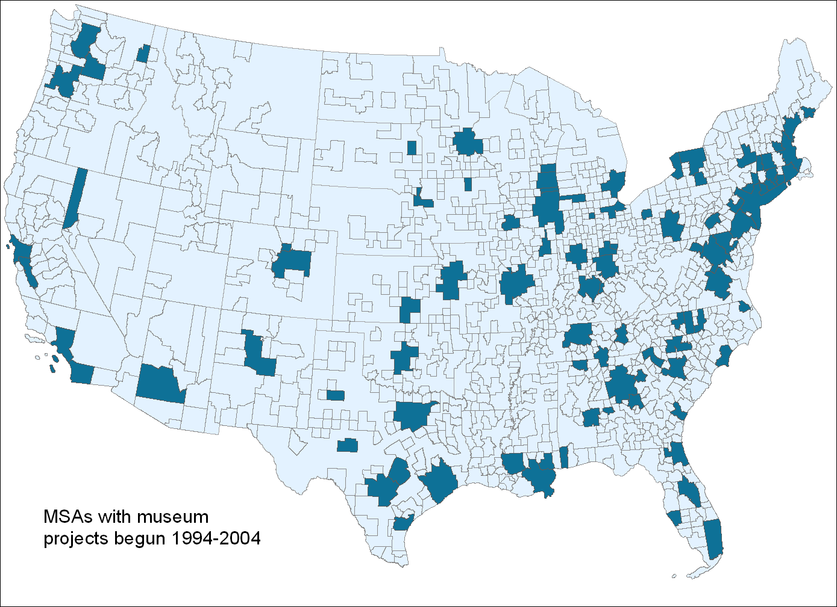
THE LANDSCAPE OF CULTURAL BUILDING

Slide 36
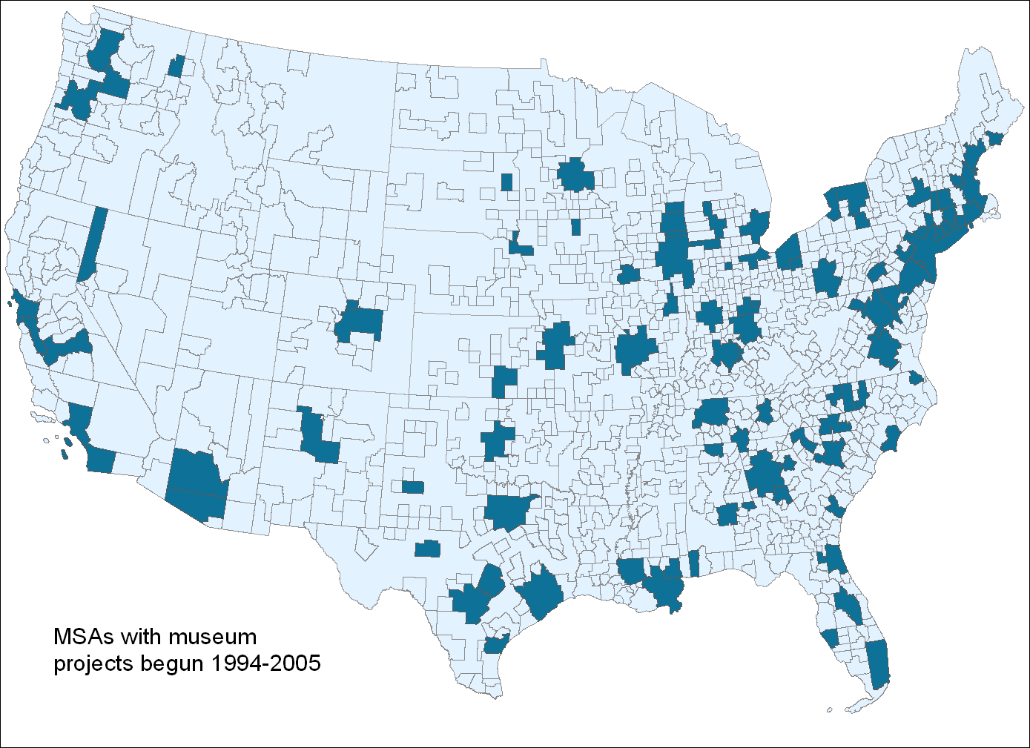
THE LANDSCAPE OF CULTURAL BUILDING

Slide 37

THE LANDSCAPE OF CULTURAL BUILDING

Slide 38
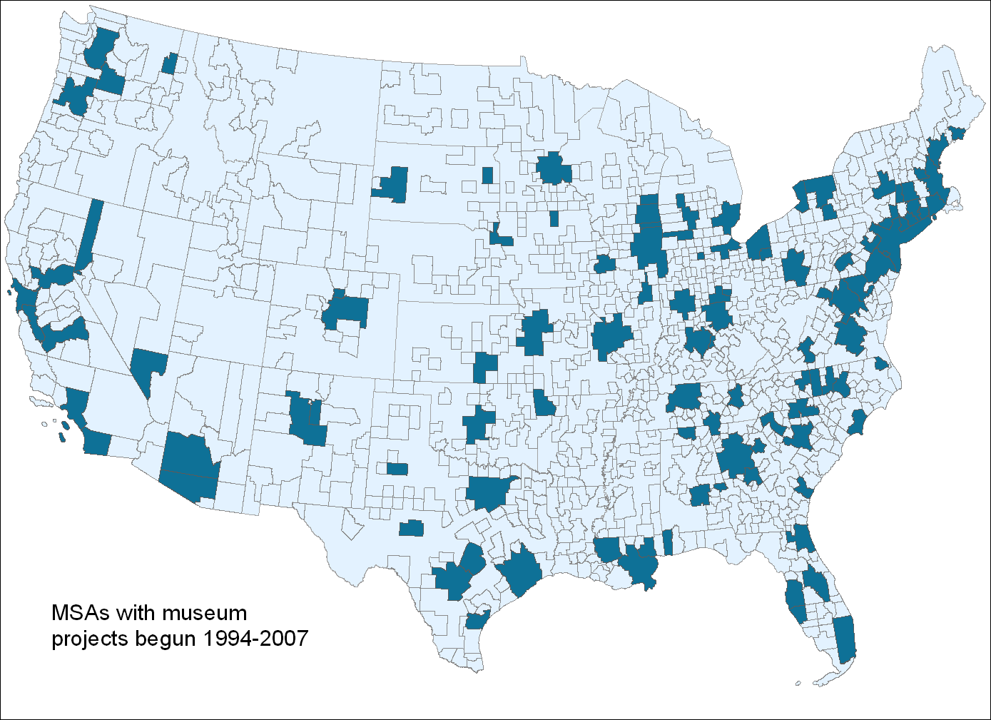
THE LANDSCAPE OF CULTURAL BUILDING

Slide 39
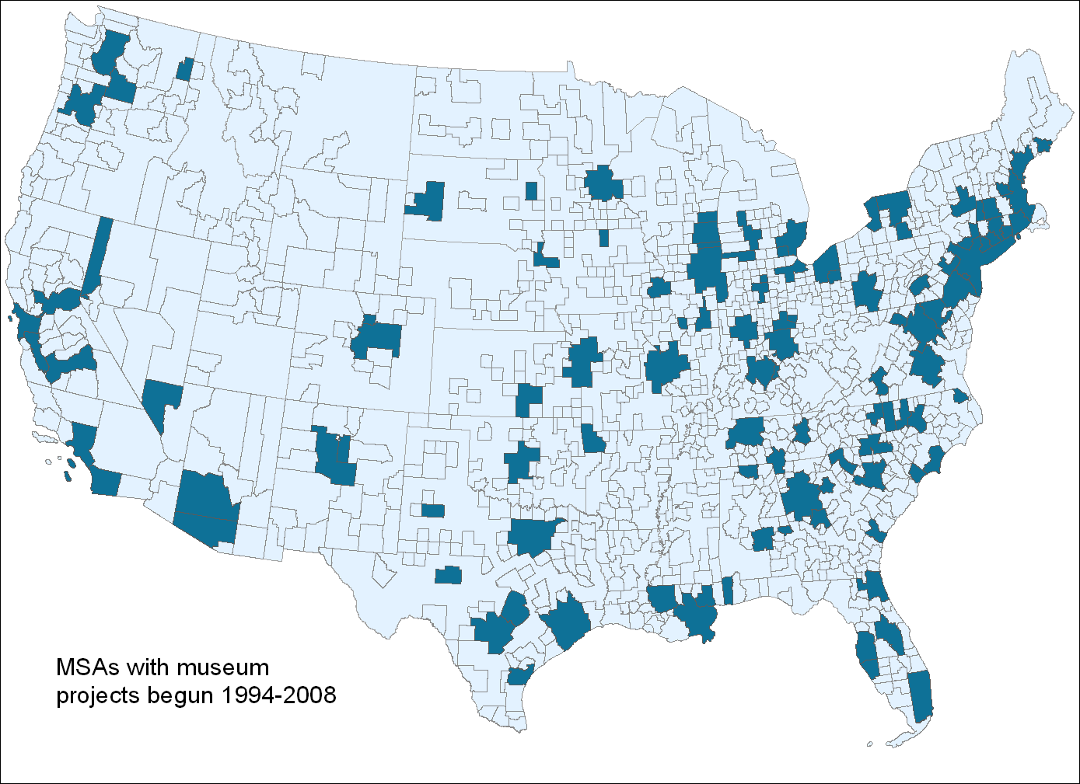
THE LANDSCAPE OF CULTURAL BUILDING

Slide 40
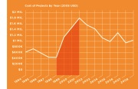
THE LANDSCAPE OF CULTURAL BUILDING
There was a substantial uptick in cultural facilities building, particularly between 1998 and 2001, the
“building boom.”
Performing arts centers (PACs) were the dominant
form of new facilities.
Building in the arts grew faster than, or on par
with, building in other sectors, particularly hospitals
and education.
The South saw a significantly greater increase in
the total number of cultural facilities during the period studied when compared to other parts of the country.
Small cities (fewer than 500,000 people) were also building, and many for the first time.
Notes:
JOANNA

Slide 41
THE LANDSCAPE OF CULTURAL BUILDING
Museums, like PACs, saw a substantial uptick in facility building between 1998 and 2001
Museum building took place primarily in the Northeastern region of the U.S.
Approximately 75% of museums were privately-owned institutions, 18% were government-owned and 7% were university-owned facilities.
Notes:
JOANNA

Slide 42
THE INVESTMENT DETERMINANTS OF CULTURAL BUILDING
Growing populations and higher average levels of education and income help explain why some cities built more than others.
The supply of cultural facilities appears to have exceeded the demand
for them, particularly during the building boom.
Notes:
JOANNA

Slide 43
THE FEASIBILITY OF CULTURAL BUILDING PROJECTS
Average Timeline for a Cultural Building Project
Year 1 | Year 2 | Year 3 | Year 4 | Year 5 | Year 6 | Year 7 | Year 8 | Year 9
Stage 1
Stage 2
Stage 3
Stage 4
Staff first start to spend time exploring the possibility of new/renovated space
Board first spent money on consultants or others to plan project
Board approved a specific construction plan with budget
Construction started
Project opening
Notes:
CARROLL

Slide 44
THE FEASIBILITY OF CULTURAL BUILDING PROJECTS
Average Timeline for a Cultural Building Project by Type of Project
Notes:
CARROLL

Slide 45
THE FEASIBILITY OF CULTURAL BUILDING PROJECTS
Average Budget Escalation for a Cultural Building Project by Type of Project
Producing Theaters | Museums | Nonresident PACs | Resident PACs
92% | 46% | 62% | 64%
Notes:
CARROLL

Slide 46
THE FEASIBILITY OF CULTURAL BUILDING PROJECTS
Percentage of Organizations that had Higher, Lower, or Same Revenues and Expenses as Projected
 | Revenues | Expenses
Higher | 20% | 59%
Lower | 54% | 7%
Same | 8% | 27%
Notes:
CARROLL

Slide 47
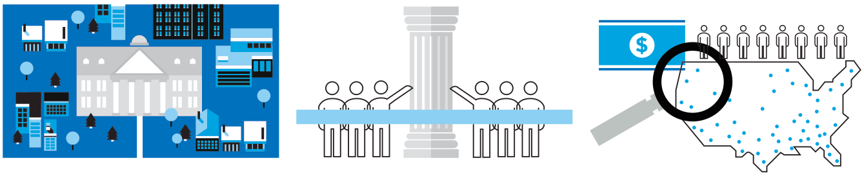
THE EFFECTS ON COMMUNITIES
• There is no clear pattern of spillover effects (negative or positive) of specific cultural building projects on non-building local cultural organizations and the greater community
• Few organizations viewed themselves as competitors of the organization that was expanding its facility.
• There was only limited evidence that cultural building has significant effects on the overall changes in the number of arts organizations, their employment, or payrolls.
Notes:
JOANNA

Slide 48
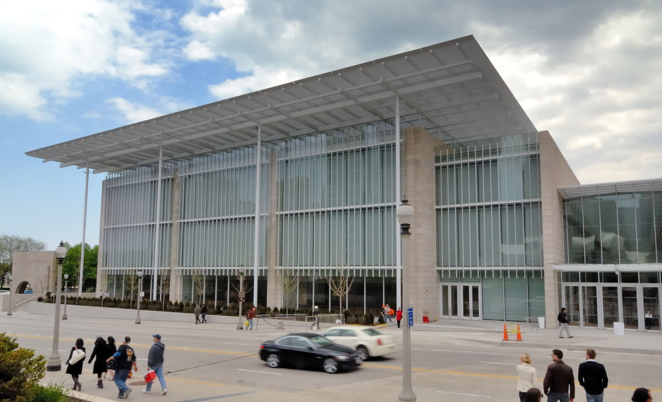
CASE STUDY The Art Institute of Chicago
Notes:
CARROLL

Slide 49
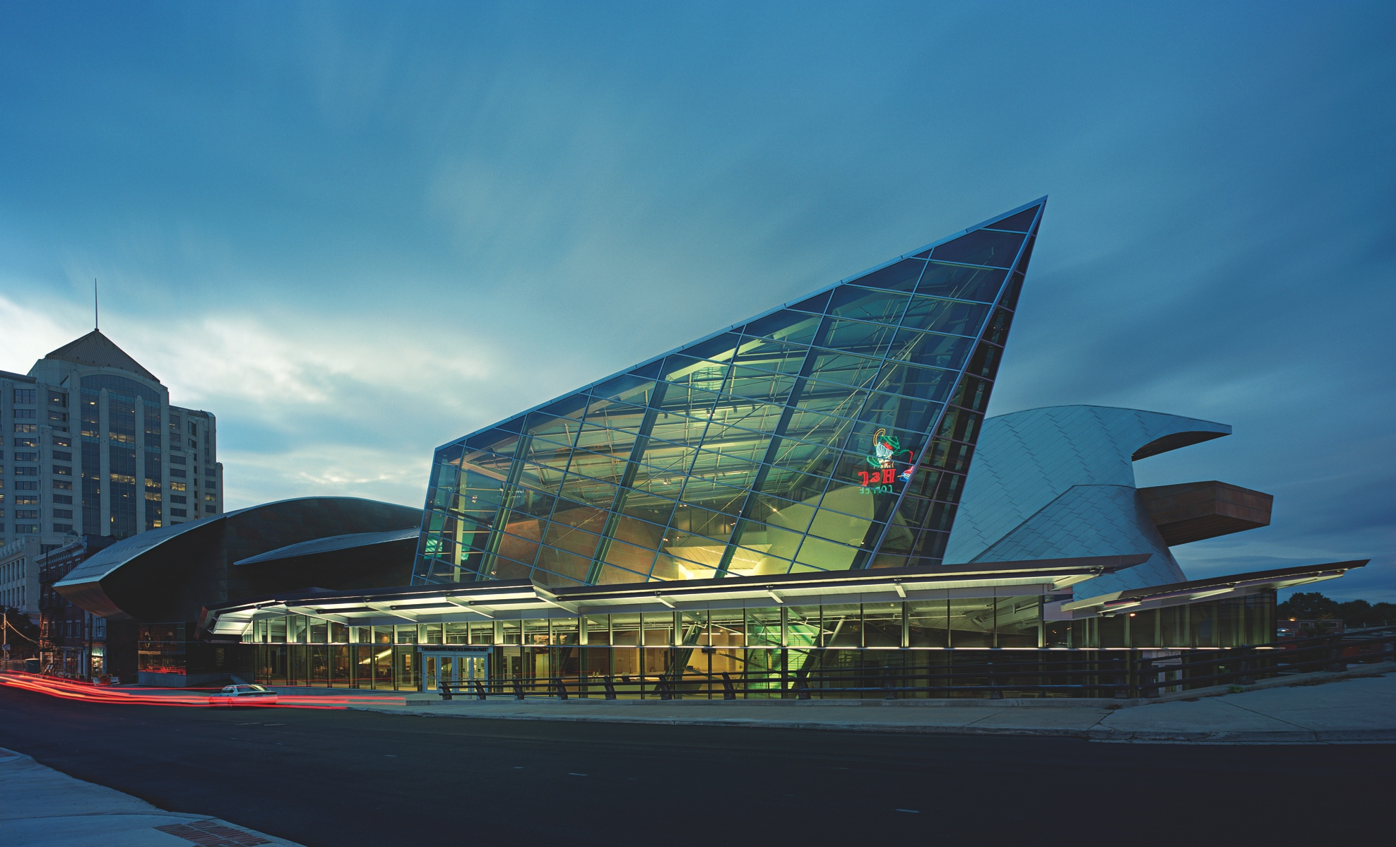
CASE STUDY Taubman Museum of Art, Roanoke
Notes:
CARROLL

Slide 50
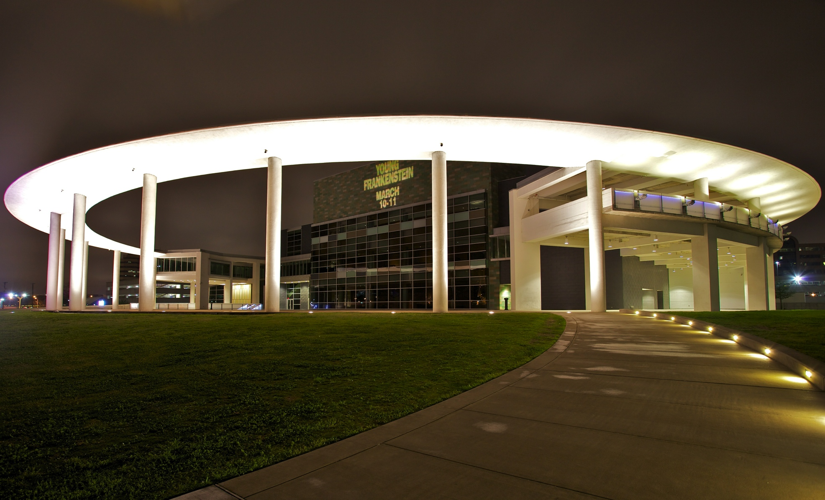
CASE STUDY Long Center, Austin
Notes:
CARROLL

Slide 51
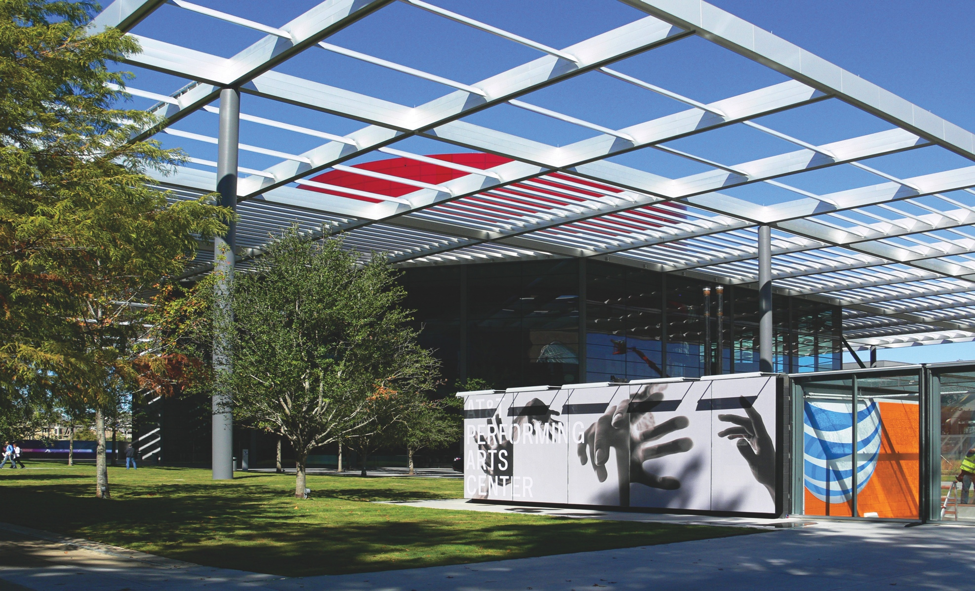
CASE STUDY AT&T PAC, Dallas
Notes:
CARROLL

Slide 52
DIMENSIONS OF SUCCESSFUL PROJECTS
Mission driven
Consistency
Motivation
Leadership
Demand Assessment
Clarity
Success
Community Feedback
Revenue Generation
Timeline
Expense Control
Implementation
Outcomes
Processes
Outcomes
Notes:
JOANNA

Slide 53
STRATEGIES FOR SUCCESS
Motivation
Artistic Mission
• Take time to identify and develop the mission
• Commit to the mission and the vision, no matter what
Organizational Need
• Distinguish between need and desire
• Assess the demand for the facility
• Recognize your competition (other organizations, arts groups, and leisure time activities)
Notes:
JOANNA

Slide 54
STRATEGIES FOR SUCCESS
Leadership
Clarity
• Identify Board and Executive leadership early on
• Establish a clear chain of command in regard to decision-making
Consistency
• Work to ensure continuity of leadership
• Have a detailed plan for managing transitions
Notes:
CARROLL

Slide 55
STRATEGIES FOR SUCCESS
Implementation
Project timeline
• Take your time during the planning stages
• Strategically determine when to announce the project to the public
Receptiveness to feedback
• Provide a forum in which critical or dissenting views can be expressed
• Avoid getting bogged down by engaging in excessive deliberation
Notes:
JOANNA

Slide 56
STRATEGIES FOR SUCCESS
Outcomes
Revenue generation
• Be conservative with income projections
• Raise the funds for the project before you start to build
• Establish reliable revenue sources
Expense control
• Set a firm limit on the budget, and do not exceed it
• Plan for unforeseen expenses
Notes:
CARROLL

Slide 57
CONTACT US
Joanna Woronkowicz
Carroll Joynes
setinstoneresearchers@gmail.com
Notes:
JOANNA

